Slide 1
Green Logistics 5 years on: Potential disruptive technologies that just might transform the supply chains of the future (and possibly be greener)
Tony Whiteing
November 2014

Slide 2
1st edition, 2010……..

Slide 3
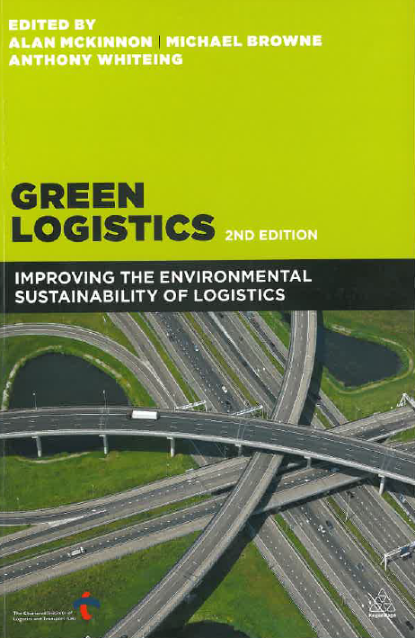
2nd edition, 2012……..

Slide 4
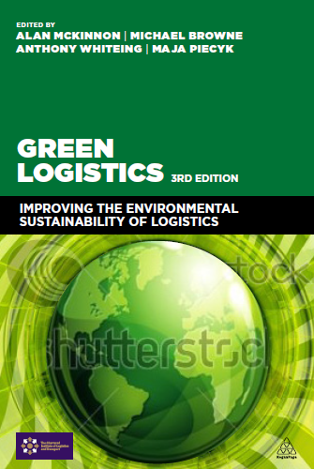
3rd edition, 2015……..
Includes some new postscripts on potential future ‘game changers’

Slide 5
Context : the global transport equation
Massive international differences in labour and manufacturing costs
+
Relatively cheap freight transport over long distances
=
Sustained long-term growth in international freight transport

Slide 6
More and more goods movement, over longer distances……
Worldwide container trade 1996-2007
(DfT, 2008)

Slide 7
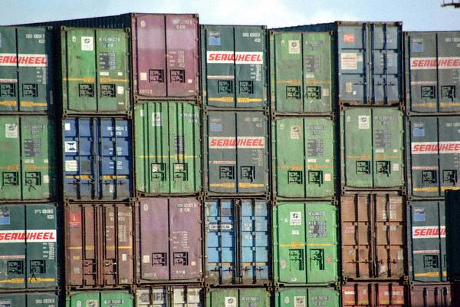
Lots of containers……..

Slide 8
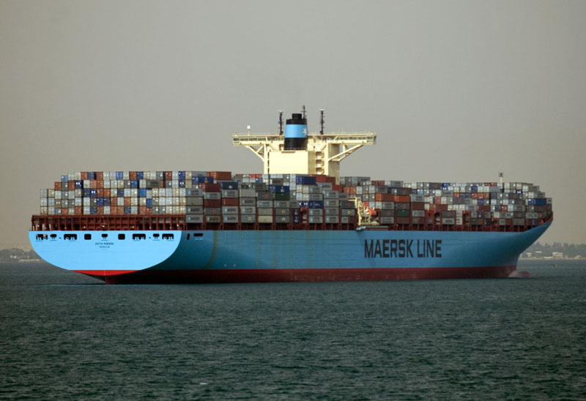
Ever larger container ships……
‘Edith Maersk’
http://commons.wikimedia.org/wiki/User:Heb

Slide 9
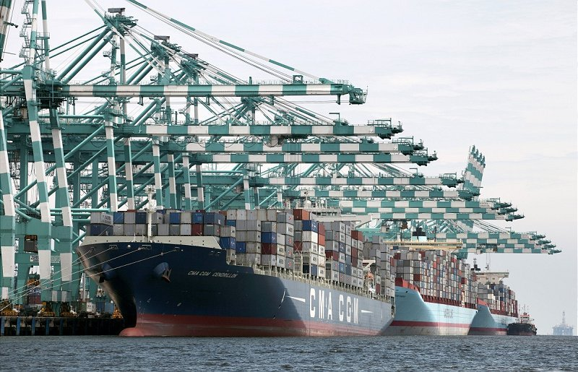
More and larger ports……
Port of Tanjung Pelepas, Malaysia

Slide 10
More and more air freight…..
Air Freight, 1989-2009 (and comparison with maritime container)
Boeing World Air Cargo Forecast 2010-2011

Slide 11
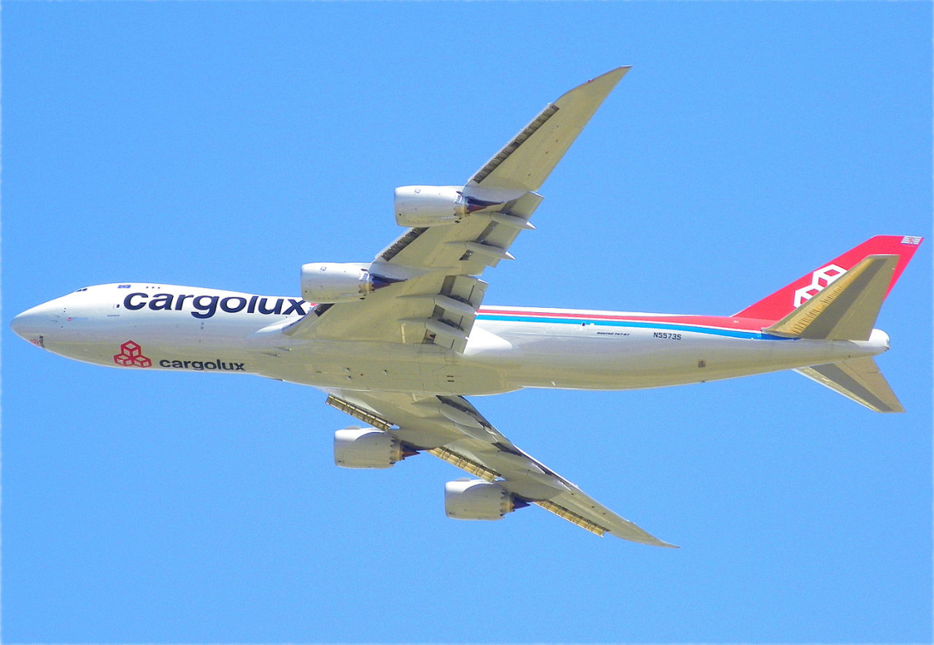
Bigger cargo aircraft….
Boeing 747-8F - with a payload of around 140 tonnes and a range of around 8000km
Cargolux 747-8F
Wikipedia, (CC) BY-SA

Slide 12
Is global freight reaching its peak?
Conventional wisdom: more GDP more freight tonne-kilometres
However, this relationship appears to have been breaking down (‘decoupling’)
Why?
At least three categories of possibilities;

Slide 13
i) Reversal of the globalisation trend
Eventually, we will run out of cheaper but more remote manufacturing locations
Some emergence of ‘re-shoring’ – i.e. bringing manufacturing back home, partly to improve supply chain resilience

Slide 14
ii) Other identifiable trends
E.g.
Changes in handling factors – essentially how many supply chain stages, and how direct they are
Miniaturisation of products
Products shipped in concentrated form (e.g. liquids)
Reduction in packaging volume
Product dematerialisation (music streaming, e-books…)
Lifestyle changes – more consumption of services, less physical product consumption

Slide 15
iii) New technologies
What do these include?
Will they make a difference, and if so, how?
For the latest edition of the book;
Various potentially disruptive technologies have been identified
Discussion of their potential effects on supply chains and their sustainability

Slide 16
1 Physical (Logistics) Internet
Logistics and the internet analogy:
On the Internet;
Deliveries are made in standard packages
Non-direct routings are used to exploit spare capacity in the network
Surely a freight transport system could utilise the same principles…??

Slide 17
Status
An emerging literature base, see in particular the works of Montreuil et al
An element of the EU European Technology Platform for Logistics (“ALICE”), www.etp-alice.eu
The concept envisages freight to be moved in standardised, smart-enabled, modular containers, enabling economies of scale through collaboration between all parties in the supply chain, e.g. the EU ‘MODULUSCHA’ project (www.modulushca.eu)

Slide 18
Green or not?
Adoption of global universal standards would allow exploitation of scale economies and major reduction in empty running
Adoption of distributed dynamic routing and scheduling allows for efficient use of network capacity
Technology could be green in its energy use and emissions

Slide 19
Barriers
Massive costs and barriers to adoption/implementation
Ownership/legal/institutional/regulatory issues around the level of business co-operation and collaboration required
Massive write-offs of existing systems and equipment

Slide 20
N. B.: Not even so-called ‘standard’ containers are standardised….

Slide 21
VERDICT
TENTATIVE
The history of freight and logistics is littered with so-called ‘standard’ intermodal technologies, loading units, transfer systems which always seemed like good ideas, but never made it
Don’t waste time on this one, move on to the next idea……

Slide 22
2 Unmanned Aerial Vehicles (UAVs) a.k.a. “Drones”
UAVs would replace vans for deliveries
Considerable publicity from the likes of Amazon and DHL in recent times
Reported to be in use in a niche logistics application in Sydney
Widely used already in other fields
Credit: The PR Group
http://www.techworld.com.au/article/528994/drones_deliver_parcels_australia_starting_march/

Slide 23
Alan McKinnon’s “11 reasons why distribution by drone is unlikely to work”
Very limited range – in the absence of a battery miracle
Impossible inventory trade-off between product range and decentralised distribution
Very high energy-intensity - energy cost per order is exorbitant
Lacks the scale economies of hub-spoke distribution and last-mile groupage
Requires very high-precision GPS to pinpoint domestic delivery points
Household reception system very difficult and costly to standardise and operate
No back-loading of an extremely expensive transport mode
Accident / liability risk
Security risk: ideal ‘clay pigeon’ target practice for guns and air rifles
Virtually no-one will value same-day delivery that highly – except a super-rich niche
Authorities very unlikely to approve use of drones in urban air-space
A McKinnon, International Conference on Logistics and Innovation, Amsterdam, 1/4/2014

Slide 24
Green or not?
Zero emission at point of use
Greener than driving to the shops?
Limited range suggests the need for an extra tier of local depots
Could lead to some reduction in van traffic - but McKinnon believes this will be modest
He also fears intrusion around homes - and around the depots fleets of drones could be continually buzzing like a swarm of wasps

Slide 25
VERDICT
TENTATIVE
If Professor McKinnon is sceptical about the practicality and sustainability of drones, then so am I
However, they could be compatible and consistent with………..

Slide 26
3 3D printing
This is the one that is receiving the most attention as a potential game-changer for markets, supply chains and logistics
3D printers are now on sale and are relatively cheap
In the future, will we print our products at home – or is this being over-hyped?
From eBay website

Slide 27
3D Printing: emerging literature
A body of academic and other thinking is now emerging….
Berman, B. (2012), 3-D printing: The new industrial revolution. Business Horizons, 55(2), pp.155–162.
Birtchnell, T, Urry, J, Cook, C and Curry, A. (2013), Freight miles: the impact of 3D printing on transport and society. Report of a workshop held as part of ESRC Project ES/J007455/1, Lancaster University, available online at http://eprints.lancs.ac.uk/66198/1/Freight_Miles_Report.pdf
Birtchnell, T and Urry, J, (2013), 3D, SF and the future. Futures, 50, pp.25–34.
Manners-Bell, J and Lyon, K. (2012), The Implications of 3D Printing for the Global Logistics Industry. Transport Intelligence Ltd, Aug 2012.
Rutkin, A., (2014), 3D printing's future is the high street, not the home, New Scientist, 2 October.
Waller, MA, Fawcett, SE. (2014), Click Here to Print a Maker Movement Supply Chain: How Invention and Entrepreneurship Will Disrupt Supply Chain Design. Journal of Business Logistics, 35(2), pp. 99–102.

Slide 28
‘3D printing's future is the high street, not the home’
Rutkin, A., 3D printing's future is the high street, not the home, New Scientist, 2 October 2014
http://www.newscientist.com/article/mg22429892.600-3d-printings-future-is-the-high-street-not-the-home.html#.VE5H-hZ4VVk
Think back to when homes had computers – but home internet and home printing had not developed widely
We wanted to use the internet – so intermediaries sprang up

Slide 29
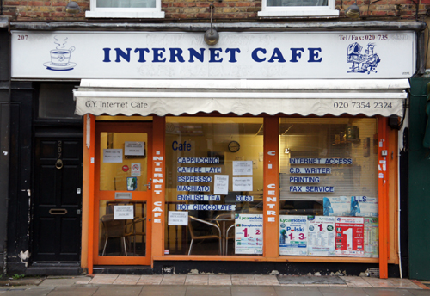
3D printing's future is the high street, not the home
Rutkin, A., 3D printing's future is the high street, not the home, New Scientist, 2 October 2014
http://www.newscientist.com/article/mg22429892.600-3d-printings-future-is-the-high-street-not-the-home.html#.VE5H-hZ4VVk
Think back to when homes had computers – but home internet and home printing had not developed widely
We wanted to use the internet – so intermediaries sprang up
From www.londonshopfronts.com

Slide 30
Evolutionary path for 3D printing
Eventually, homes may possess good affordable 3D printers – but this is some way off?
More likely that 3D printing will become a local service?
3D PRINTING
From www.londonshopfronts.com

Slide 31
How it might work
Order online from such as Amazon
Amazon takes your money
Amazon signs up with a network of local franchise 3D printing operators
Your order is passed to the local franchise, and supply of materials is organised
The franchise prints your order
Local delivery or customer collection

Slide 32
Green or not?
Manners –Bell and Lyons (2012) and others believe this to be a serious challenger to today’s mass-production globalised supply chains and express freight industries
Customised, low-waste production at or close to point of consumption
Less global transport, less warehousing, less packaging
Localised distribution – could be by greener modes
However;
Public cynicism about product quality and machine reliability
Not transport-free – still needs highly dispersed transport of materials for the printers, in relatively frequent small shipments

Slide 33
VERDICT
TENTATIVE
3D printing is the space to watch in the foreseeable future!

Slide 34
Overall,
Technological development is notoriously difficult to predict
So I confidently expect I will be proved wrong in most of this
However, in the medium to longer term the ideas presented and discussed here should not be dismissed lightly.
Acknowledgement
Tony Whiteing would like to thank his ‘Green Logistics’ co-editors for materials used in this presentation

