Slide 1

The practice of transport planning: looking to studies of science to reveal why it matters
Institute for Transport Studies
FACULTY OF ENVIRONMENT
Ian Jones

Slide 2
Institute for Transport Studies
FACULTY OF ENVIRONMENT
Presentation outline and key objective
  The practice of transport planning
  Sociology of scientific knowledge (SSK)
  Examples of practice drawn from a case study of how practitioners allocate space allocation in Melbourne, Australia
  Objective: Reveal how SSK helps develop a more nuanced and realistic account of practice and what this means for policy

Slide 3
Institute for Transport Studies
FACULTY OF ENVIRONMENT
The car paradigm provides a narrow view of mobility
  The narrow view is problematic:
    Provides limited understanding of travel more generally (Cass, Shove & Urry, 2004; Friedmann, 1993; Graham & Healey, 1990)
    Insufficient to understand relationship between car-reliant infrastructure and rising social inequality (Dodson & Sipe, 2008) and splintered urban infrastructure (Graham & Marvin, 2002)
    Fails to appreciate emerging trends—at least in Melbourne—of travel to work patterns shifting from the car to public transport (Mees & Groenhart, 2014)
    Does little to help resolve climate change (Banister, 2011)

Slide 4


Institute for Transport Studies
FACULTY OF ENVIRONMENT
The lens of science studies
Robert Evans
Stephan Graham
Simon Guy
Simon Marvin
Science studies
Sociology of scientific knowledge (SSK)
History of science and technology (HST)
Science, technology and society (STS)
Social construction of technology (SCOT)

Slide 5

Institute for Transport Studies
FACULTY OF ENVIRONMENT
Scientists
Human agents manoeuvring in a field of material agency
Sociology of scientific knowledge
Scientific culture
Made things of science, such as skills, social relations, machines, scientific facts and theories
Scientific stuff
Problems can and do arise that require scientists to resolve by engaging with machines - the contours of which are not known in advance

Slide 6
Institute for Transport Studies
FACULTY OF ENVIRONMENT
Road space allocation
  Traditional broad terms
    Travel Demand Management (TDM)
    Transportation System Management (TSM)
    Intelligent Transportation Systems (ITS)
  Examples in practice
    Shared Space (Aus) begin circa 1990
    Mixed Priority Routes (UK) begin circa 2000
    Context Sensitive Solutions (US) begin circa 2000
  Conceptual ideas around how and why to allocate road space
    Mumford’s (1963) “city as theatre”
    Jacob’s (1961) “street ballet”
    Whyte’s (1988) “stage”
    Rosales, J. (2006). Road diet handbook
    Jones, P., Boujenko, N., & Marshall, S. (2007). Link & Place
    McCann, B. (2013). Completing our streets
    VicRoads (2013) SmartRoads
    Nielson, G. (2005). HiTrans Best Practice Guide 2: Public transport - Planning the networks

Slide 7
Institute for Transport Studies
FACULTY OF ENVIRONMENT
Map of Australia and Melbourne metropolitan area

Slide 8
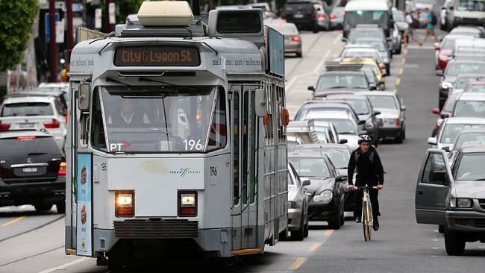
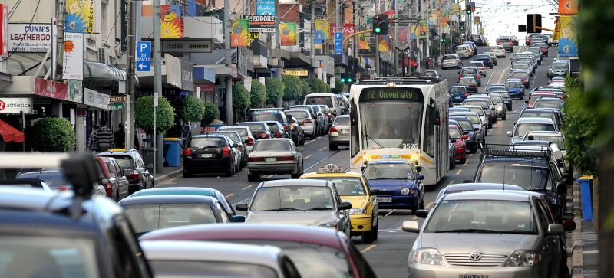
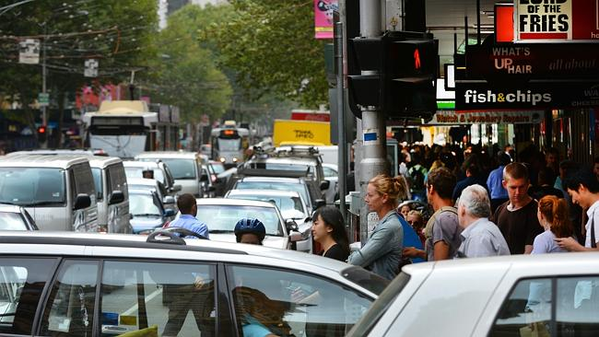
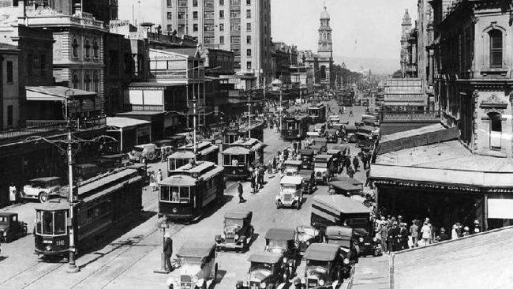
Institute for Transport Studies
FACULTY OF ENVIRONMENT

Slide 9
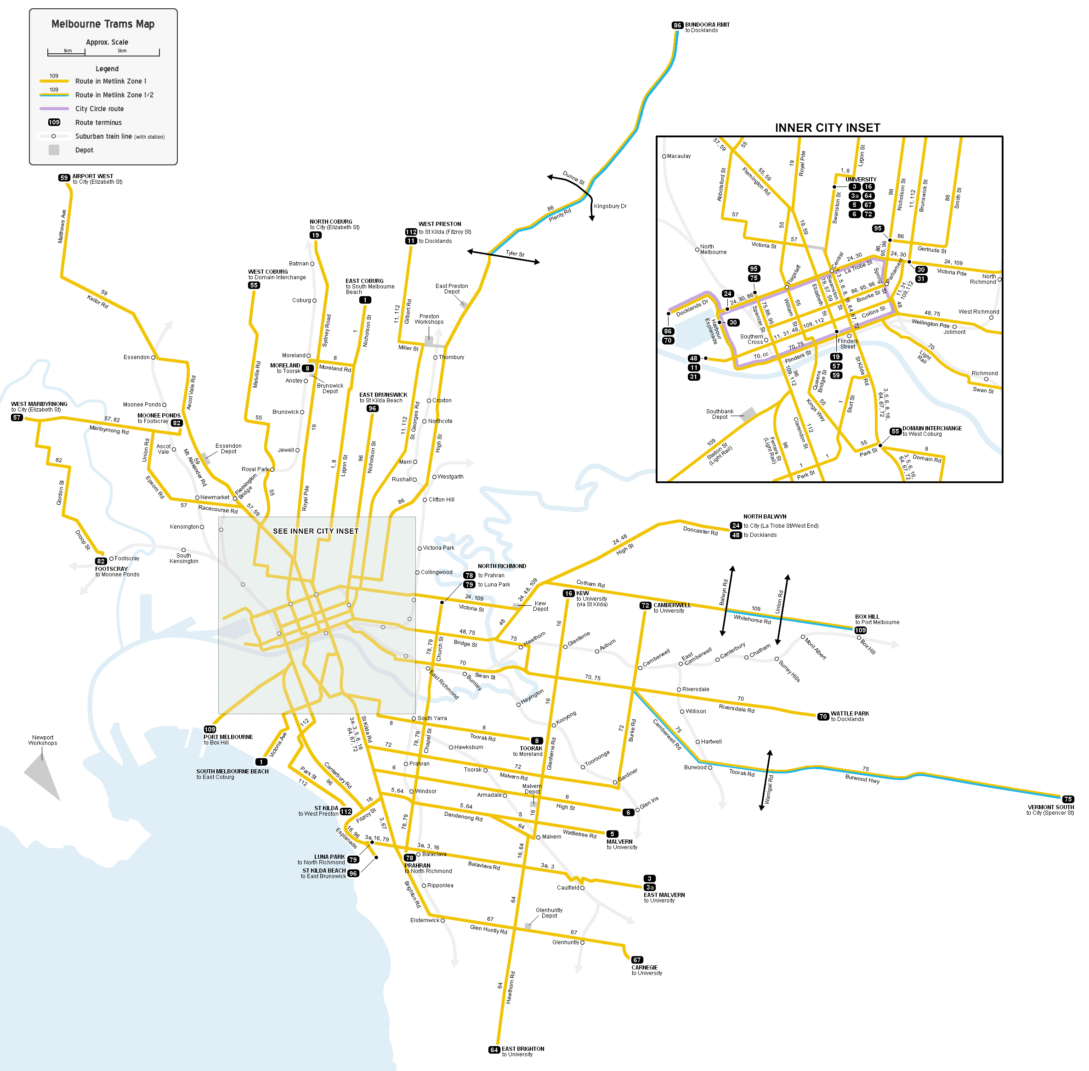
Institute for Transport Studies
FACULTY OF ENVIRONMENT

Slide 10
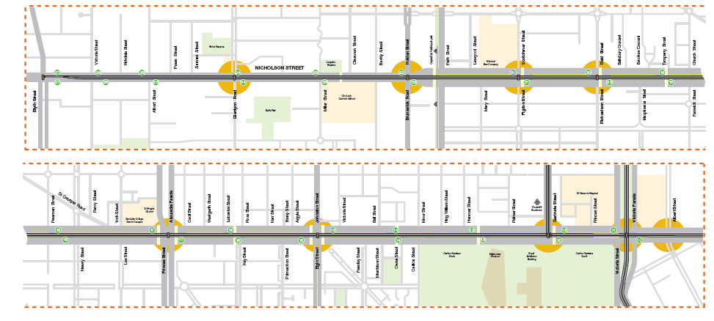
Institute for Transport Studies
FACULTY OF ENVIRONMENT
Nicholson Street Route 96 Full Tram Priority Trial

Slide 11

Institute for Transport Studies
FACULTY OF ENVIRONMENT
Nicholson Street Route 96 Full Tram Priority Trial

Slide 12
Institute for Transport Studies
FACULTY OF ENVIRONMENT
Nicholson Street Route 96 Full Tram Priority Trial

Slide 13
Institute for Transport Studies
FACULTY OF ENVIRONMENT
Nicholson Street Route 96 Full Tram Priority Trial

Slide 14
Institute for Transport Studies
FACULTY OF ENVIRONMENT
Nicholson Street Route 96 Full Tram Priority Trial

Slide 15
Institute for Transport Studies
FACULTY OF ENVIRONMENT
Nicholson Street Route 96 Full Tram Priority Trial

Slide 16
Institute for Transport Studies
FACULTY OF ENVIRONMENT
Nicholson Street Route 96 Full Tram Priority Trial

Slide 17

Institute for Transport Studies
FACULTY OF ENVIRONMENT
Nicholson Street Route 96 Full Tram Priority Trial

Slide 18
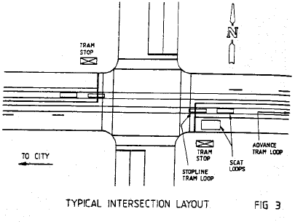
Institute for Transport Studies
FACULTY OF ENVIRONMENT
Nicholson Street Route 96 Full Tram Priority Trial

Slide 19
Institute for Transport Studies
FACULTY OF ENVIRONMENT
Nicholson Street Route 96 Full Tram Priority Trial

Slide 20
Institute for Transport Studies
FACULTY OF ENVIRONMENT
Nicholson Street Route 96 Full Tram Priority Trial

Slide 21
Institute for Transport Studies
FACULTY OF ENVIRONMENT
Traditional accounts of practice
 | Scientists | Scientific culture | Scientific stuff
Finding | Normative decisions Politics Mandated responsibilities | Normative decisions Politics Mandated responsibilities | Normative decisions Politics Mandated responsibilities Infrastructure
Approach | Closer grained analysis Solutions oriented | Wide reach/Policy Constraint oriented | Historical Methodology oriented
Literature | Urban studies | Transport, some cross over | History
Gaps | Actor Materiality | Performance Materiality | Not contemporary

Slide 22
Institute for Transport Studies
FACULTY OF ENVIRONMENT
Traditional accounts of practice
 | Scientists | Scientific culture | Scientific stuff
Finding | Normative decisions Politics Mandated responsibilities | Normative decisions Politics Mandated responsibilities | Normative decisions Politics Mandated responsibilities Infrastructure
Approach | Closer grained analysis Solutions oriented | Wide reach/Policy Constraint oriented | Historical Methodology oriented
Literature | Urban studies | Transport, some cross over | History
Gaps | Actor Materiality | Performance Materiality | Not contemporary

Slide 23
Institute for Transport Studies
FACULTY OF ENVIRONMENT
Traditional accounts of practice
 | Scientists | Scientific culture | Scientific stuff
Finding | Normative decisions Politics Mandated responsibilities | Normative decisions Politics Mandated responsibilities | Normative decisions Politics Mandated responsibilities Infrastructure
Approach | Closer grained analysis Solutions oriented | Wide reach/Policy Constraint oriented | Historical Methodology oriented
Literature | Urban studies | Transport, some cross over | History
Gaps | Actor Materiality | Performance Materiality | Not contemporary

Slide 24
Institute for Transport Studies
FACULTY OF ENVIRONMENT
Traditional accounts of practice
 | Scientists | Scientific culture | Scientific stuff
Finding | Normative decisions Politics Mandated responsibilities | Normative decisions Politics Mandated responsibilities | Normative decisions Politics Mandated responsibilities Infrastructure
Approach | Closer grained analysis Solutions oriented | Wide reach/Policy Constraint oriented | Historical Methodology oriented
Literature | Urban studies | Transport, some cross over | History
Gaps | Actor Materiality | Performance Materiality | Not contemporary

Slide 25
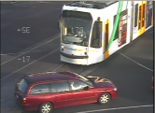
Institute for Transport Studies
FACULTY OF ENVIRONMENT
Nicholson Street Route 96 Full Tram Priority Trial

Slide 26
Institute for Transport Studies
FACULTY OF ENVIRONMENT
Developing a more nuanced and realistic account of practice
 | Scientists | Scientific culture | Scientific stuff
Finding | Normative decisions Politics Mandated responsibilities | Normative decisions Politics Mandated responsibilities | Normative decisions Politics Mandated responsibilities Infrastructure
Approach | Closer grained analysis Solutions oriented | Wide reach/Policy Constraint oriented | Historical Methodology oriented
Literature | Urban studies | Transport, some cross over | History
Gaps | Actor Materiality | Performance Materiality | Not contemporary

Slide 27
Institute for Transport Studies
FACULTY OF ENVIRONMENT
Implications for policy from developing a more realistic picture of the science of transport planning
Applying SKK as a critical lens to urban studies literature reveals important discrepancies
Dominance of traffic engineering in transport planning
Loss of institutional knowledge
Past performances shape future outcomes

Slide 28
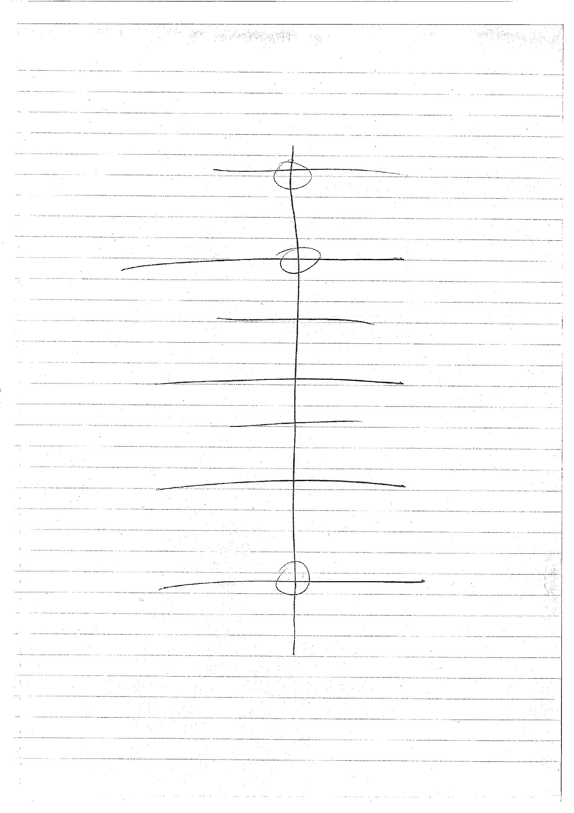
Institute for Transport Studies
FACULTY OF ENVIRONMENT
  Author’s sketch from interview
Circles indicative and helped convey the professional’s main points.
From a network perspective, leaving these intersections alone would result in negligible impacts to Melbourne’s road network.
Thus, giving priority on intersections that impacted the network the least would result in X, additional intersections would result in Y, and all nine intersections would be Z.
X
Y
Z

Slide 29
Institute for Transport Studies
FACULTY OF ENVIRONMENT
Implications for policy from developing a more realistic picture of the science of transport planning
Applying SKK as a critical lens to urban studies literature reveals important discrepancies
Dominance of traffic engineering in transport planning
Loss of institutional knowledge
Past performances shape future outcomes

Slide 30
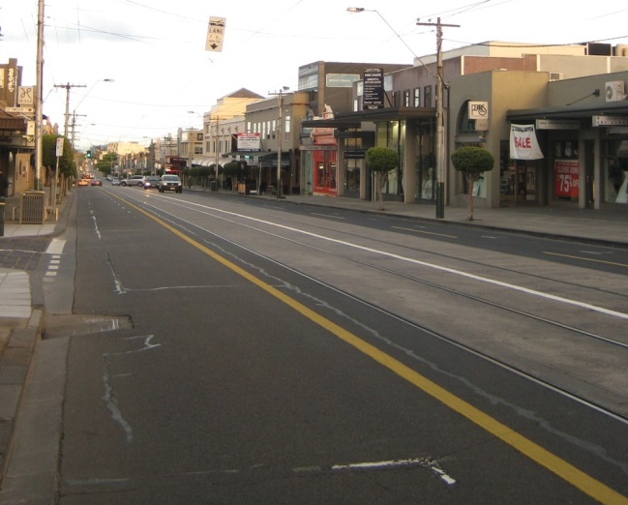
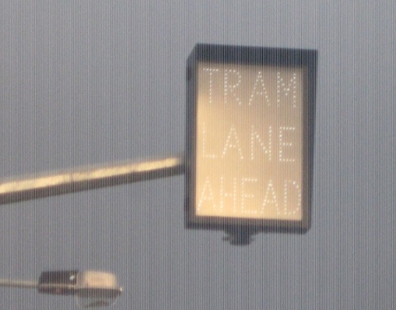
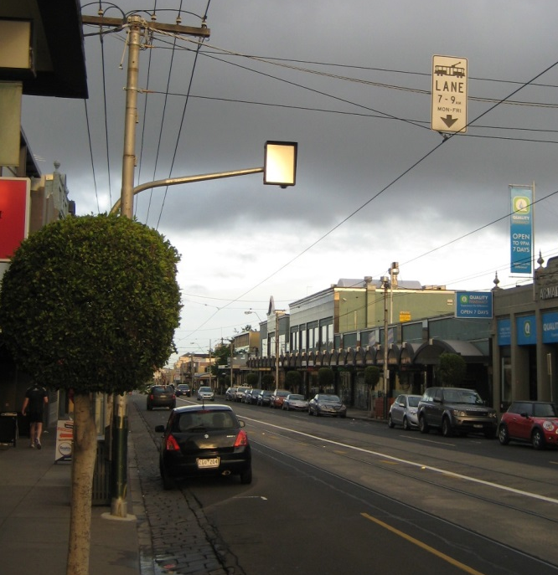
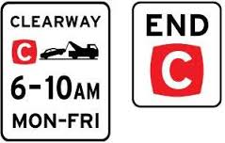
Institute for Transport Studies
FACULTY OF ENVIRONMENT
  New flashing Fairway sign
  Signs blink “tram lane ahead” and “merge left”
  Fairway tram line
  New embedded flashing road measures
  Clearway sign

Slide 31
Institute for Transport Studies
FACULTY OF ENVIRONMENT
Thank you

