Slide 1
Exposure to traffic-related air pollution and the onset of childhood asthma: is there a connection?
Institute for Transport Studies
FACULTY OF ENVIRONMENT
Haneen Khreis¹, Charlotte Kelly^{1,2}, James Tate¹, Roger Parslow³ and Karen Lucas¹
¹Institute for Transport Studies, ²Academic Unit for Health Economics, ³Division of Epidemiology and Biostatistics

Slide 2
Contents
Context
Overall methodology
The systematic review
Preliminary results
Implications
Conclusions
Future work
Acknowledgement
References

Slide 3
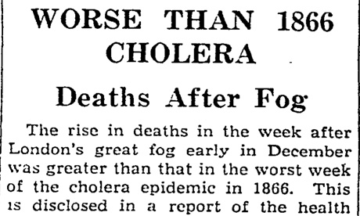
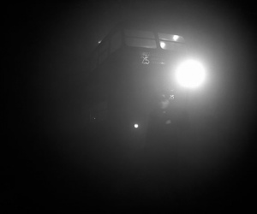
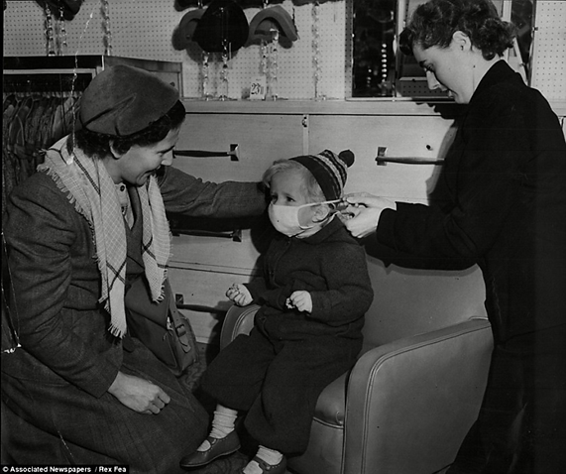
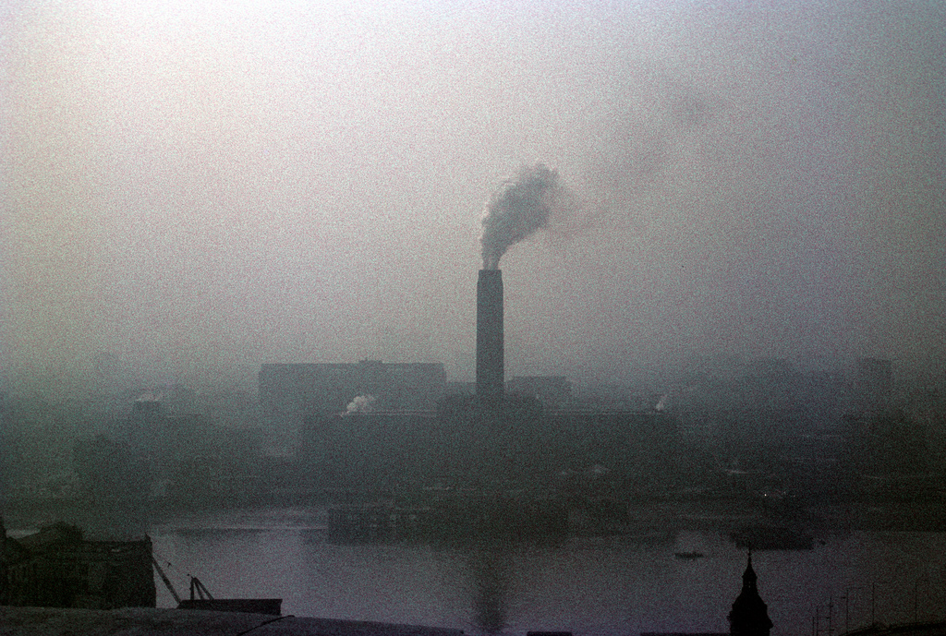
Over sixty years ago…
1
2
3
4
Notes:
Pictures courtesy of 1. http://www.theguardian.com/theguardian/from-the-archive-blog/2012/dec/05/great-smog-london-1952-archive
2. http://www.theguardian.com/environment/gallery/2012/dec/05/60-years-great-smog-london-in-pictures
3. http://piracybay.blogspot.co.uk/2012/12/funonthenet-great-smog-of-london-60.html
4. http://www.sagemagazine.org/lessons-from-air-pollution-past/

Slide 4
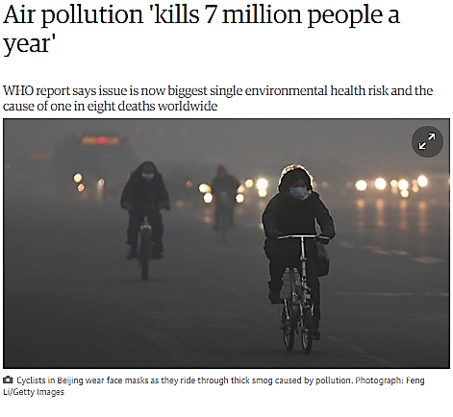
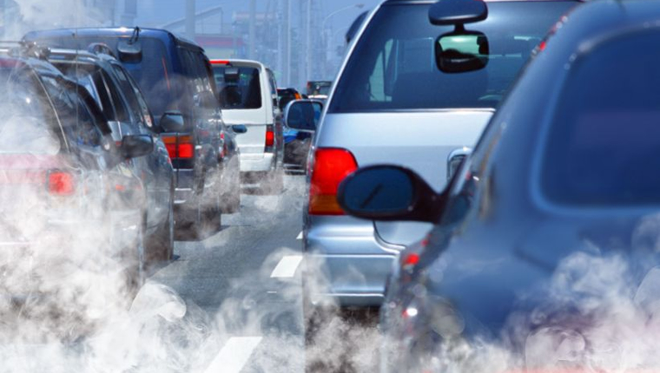
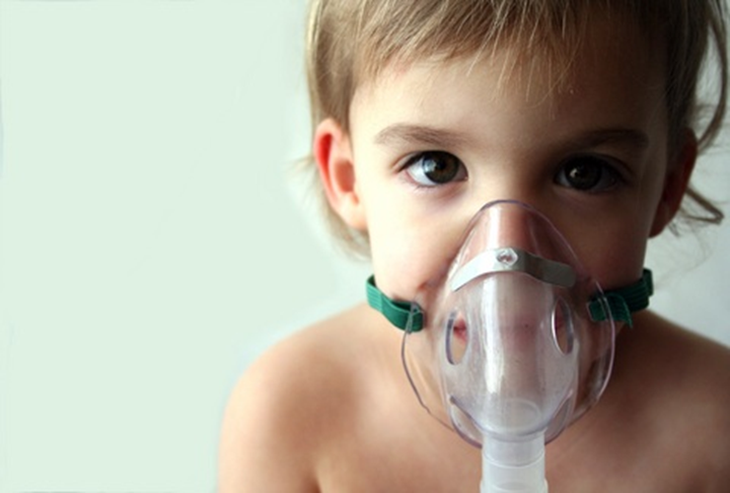
…Today
2
1
3
Notes:
Pictures courtesy of 1. http://www.theguardian.com/environment/2014/mar/25/air-pollution-kills-7m-people-a-year
2. http://elinussbaum.com/traffic-related-air-pollution-and-lung-function-in-children-at-8-years-of-age/
3. http://getwellhere.com/asthma-in-children-lets-treat-the-cause/

Slide 5
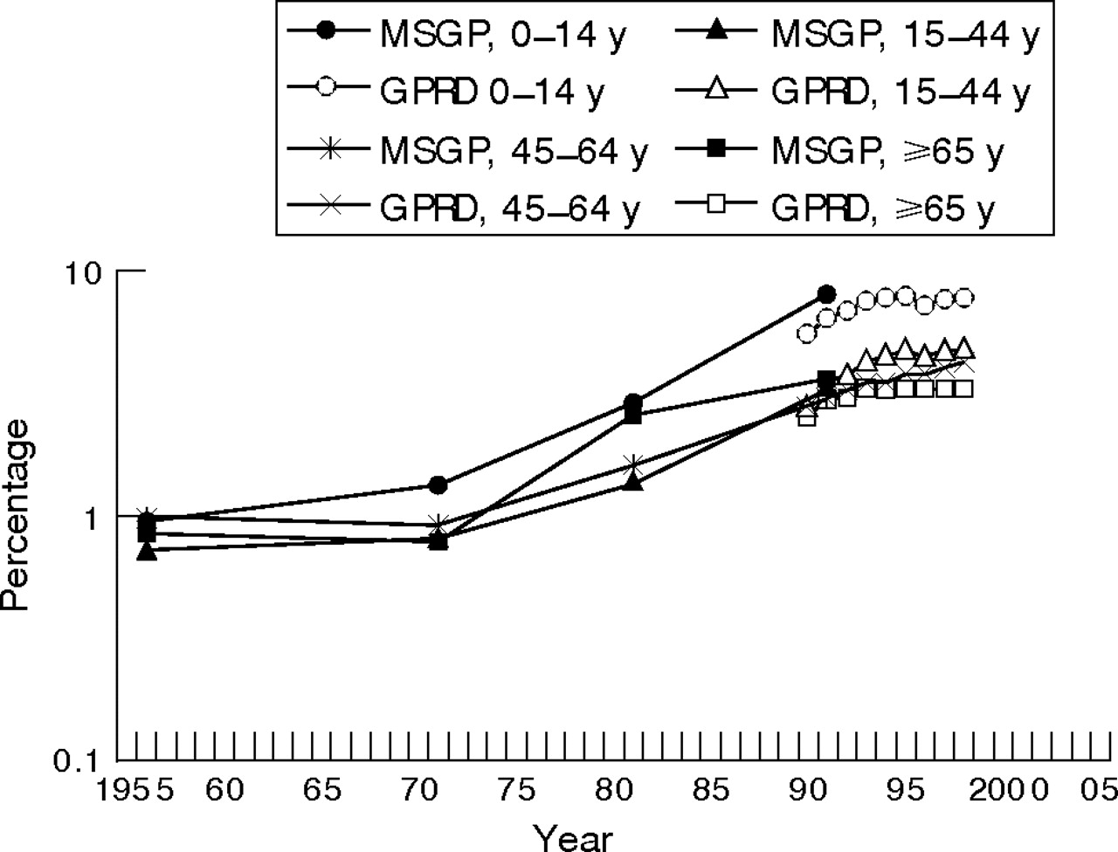
Childhood asthma on the rise
A complex inflammatory disorder of the airways
Significant and steady increases in prevalence after the 1950’s
“… the increase in disease must be attributable to a change in as-yet unknown environmental factors” (Cookson, 2004)
Patients consulting general practitioners for asthma per 10 000 population, England and Wales, 1955–1998. Data from the General Practice Research Database (GPRD) and Morbidity Statistics in General Practice (MSGP). y, year, (Anderson et al. 2007)

Slide 6
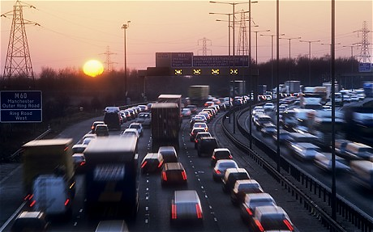
Conventional wisdom about air pollution and asthma
Air pollution can exacerbate existing asthma
Unclear and debatable whether air pollution can cause asthma
Was argued that air pollution can be excluded as a plausible cause of asthma as air quality improved when asthma prevalence was on the rise (Anderson 1997, Koenig 1999)
1
2
Notes:
Pictures courtesy of 1. http://classroom.synonym.com/recycling-influence-air-pollution-8489.html
2. http://www.telegraph.co.uk/news/science/8815901/Air-pollution-from-traffic-impairs-brain.html

Slide 7
Challenging the conventional wisdom
“…I think we’ve been looking for the last thirty years at the wrong pollutant mixture and I also think as you’ll see, I think that that history has got in the way of advancing our understanding of the role of air pollution in asthma, and has limited our approach to risk assessment…”
Rob S. McConnell, MD. Professor of Preventive Medicine, USC, at Symposium on Cumulative Impacts and Children's Environmental Health 2013

Slide 8
Overall methodology
Systematic review
Meta-analysis
Case study
Does children’s exposure to traffic-related air pollution increase their risks of developing asthma?
Provide data
Learn and apply lessons

Slide 9
Eligibility criteria
Does children’s exposure to traffic-related air pollution increase their risks of developing asthma?
3. Include studies which investigate children’s exposure to traffic-related air pollution only
1. Include human studies only 2. and children’s studies only
4. Include studies which investigate exposure to traffic-related air pollution or traffic-related air pollutants when road traffic is specified as their source
5. Include studies which report measures of association and their confidence interval precision
6. Include studies which specifically investigate asthma’s development risks in childhood
7. Include observational studies only

Slide 10
Search strategy
Protocol registered specifying methods/ stages (Khreis et al., 2014)
Structured searches in EMBASE, MEDLINE, Transport Database
No language or study date restriction in database searches in line with CRD guidance (Tacconelli, 2010)
Population
Child*
Child*
Exposure
Air pollution
Ultrafine particles
Outcome
Asthma
Asthma
Child*
Air quality
Asthma
Child*
Vehicle emissions
Asthma

Slide 11
Studies identified by the databases searches N = 3,784
Studies identified from previous literature review N = 16
13th August 2014 - 6th March 2015
Excluded N = 1,180; duplicates and triplets
Stage 1
Titles and abstracts screened N = 2,620
Excluded N = 2,559; one or more of eligibility criteria unmet
Random 10% independently screened by CK
Potentially relevant studies to be full-text screened for eligibility N = 61
Excluded N = 6;
1 review, 1 foreign language, 3 abstracts no paper, 1 abstract paper included
Stage 2
Full copies obtained and assessed for eligibility N = 55
Excluded N = 34; one or more eligibility criteria unmet
Random 10% independently screened by JT
3 relevant reviews from stage 1
Stage 3
Publications meeting inclusion criteria and included in the review N = 21
References lists screening: identified 3 reviews (+3 reviews from stage 1), data extraction, and quality assessment

Slide 12
Data extraction and quality assessment (CASP, 2004)
Study design
Cohort vs case-control
Recruitment and selection bias
Representative? Anything special? Everyone included?
Sample size
Statistical power to detect effects
Age group
Any critical exposure windows?
Completion and length of the follow-up
Do persons lost to follow-up have different outcomes? Is follow-up long enough to reveal effects?
Adjustment for confounders and other risk factors
Identification, control and adjustment for confounders and other asthma risk factor?
Exposure assessment methods
Methods? Limitations? Validation? Traffic-related pollutants studied?

Slide 13
Lack of emphasis on asthma onset

Slide 14
Lack of emphasis on asthma onset
Only 21 studies identified [1999-2014]
But almost every other study looked at air pollution and asthma exacerbations or asthma prevalence at one point in time
Why is the evidence for the effect of exposure to traffic-related air pollution on asthma’s onset considerably less developed?
Lack of population cohorts capable of assessing disease onset?
Access to/ utilization of cohort studies data limited by costs, ethics and multidisciplinary collaboration?
Whether a causal relationship between traffic-related air pollution and asthma exist is not only a question for epidemiologists, but is also a question of biological plausibility

Slide 15
Countries of origin

Slide 16
Countries of origin
1
2
2
3
1
1
6
1
3
1

Slide 17
Focus on the 16 cohort studies
1
2
2
3
1
3
1
3

Slide 18
General characteristics

Slide 19
General characteristics (16 cohorts)
Sample sizes
Ranged from 184 to 37,401 children
Follow-up periods
Ranged from 2 to 12 years (11 studies were birth cohorts)
Exposure validation
8 studies reported some kind of exposure validation
Exposure calculated at:
At the home address: 15 studies
At the school address: 1 study
Adjustment for confounders
Smoking, socio-economic status, indoor air pollution sources, gender, family history of asthma and allergies, low birth weight and gestational period

Slide 20
Asthma’s definitions

Slide 21
Asthma’s definitions and almost no categorization!
9 studies > questionnaires’ self or parental reporting of doctor-diagnosed asthma
Diagnostic criteria/ practices vary among countries/ physicians
Asthma prevalence estimates significantly differ using parental report of doctor diagnoses vs. medication data vs. hospitalization registry (Hansen et al., 2012)
7 studies > symptoms reporting, asthma treatment, primary care billing/ hospital discharge records
Symptoms are non specific
Asthma is heterogeneous in nature, has different endotypes with distinct underlying mechanisms
Only 2 studies categorized asthma as allergic vs. non-allergic

Slide 22
Exposure assessment

Slide 23
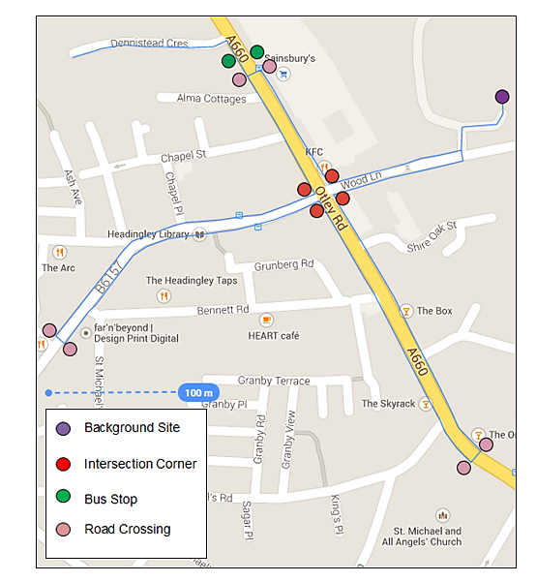
Traffic-related air pollution is highly heterogeneous in space and in time
Fay D, Tate J, Khreis H, (2015): Investigating pedestrians PNC exposures in urban micro-environments near a busy road traffic intersection

Slide 24
Traffic-related air pollution is highly heterogeneous in space and in time

Slide 25
Land-use regression models: 7 studies
Land use area/ # of buildings = BUILDINGS
NO₂ = 16.52 + 7.81E-5*BUILDINGS_300 + 5.86E-6*TRAFLOAD_25 + 3.20E-8*TRAFLOAD_25_1000 − 1.09E-4*NATURAL_300 + 7.43E-4*HEAVYTRAFMAJOR
(Beelen et al., 2013)
Total traffic load of all roads in buffer = TRAFLOAD
PICTURES HAVE BEEN REMOVED DUE TO CONFIDENTIALITY ISSUES
Sum of green, natural, forested area in buffer = NATURAL
Heavy duty traffic intensity on nearest major road= HEAVYTRAFMAJOR
Traffic intensity on nearest major road = TRAFMAJOR
Notes:
BUILDINGS = Area of the land use in that buffer / number of buildings (m2/number), TRAFLOAD = Total traffic load of all roads in a buffer (sum of (traffic intensity*length of all segments)) (veh.day−1 * m), NATURAL = Sum of urban green and semi-natural and forested areas in that buffer (m2), HEAVYTRAFMAJOR = Heavy-duty traffic intensity on nearest major road (veh.day-1), and TRAFMAJOR = Traffic intensity on nearest major road (veh.day-1)

Slide 26
Land-use regression models: 7 studies
Sensitive to the number/ locations of sampling sites
NO₂ = 16.52 + 7.81E-5*BUILDINGS_300 + 5.86E-6*TRAFLOAD_25 + 3.20E-8*TRAFLOAD_25_1000 − 1.09E-4*NATURAL_300 + 7.43E-4*HEAVYTRAFMAJOR
(Beelen et al., 2013)
Depend on selecting meaningful predictors
PICTURES HAVE BEEN REMOVED DUE TO CONFIDENTIALITY ISSUES
Exposure misclassification varies by pollutants
Cancels out any seasonal variations and any peaks
Notes:
Cross-validation analysis showed that the land use regression models for NO and NO2 performed better than the models for PM2.5 and black carbon

Slide 27
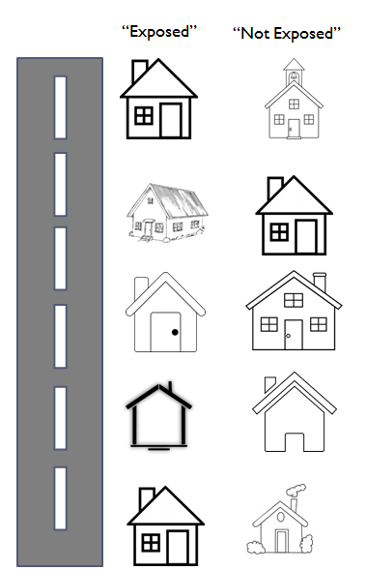
Proximity to major roads: 7 studies
No direct information on pollutants
Definition of a ‘major road’ can be subjective and was highly heterogeneous across studies
Does not consider compounded effects of multiple roads or smaller roads proximity
Exposure misclassification especially when not considering vehicular mix/ traffic conditions
High potential of confounding
Notes:
Distance to major road, represents exposure to traffic but may also express socioeconomic status, traffic noise, neighbourhood conditions, which entails difficulties in separating these effects

Slide 28
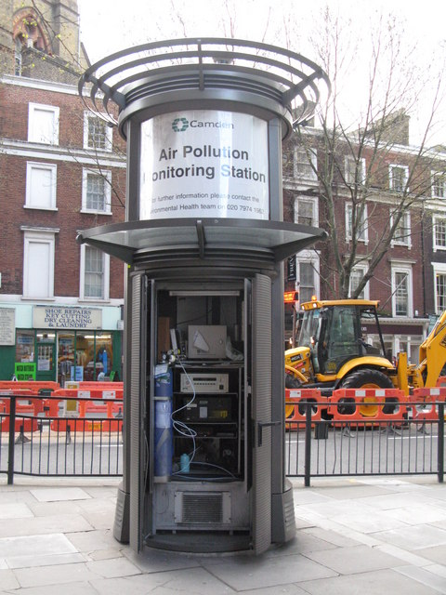
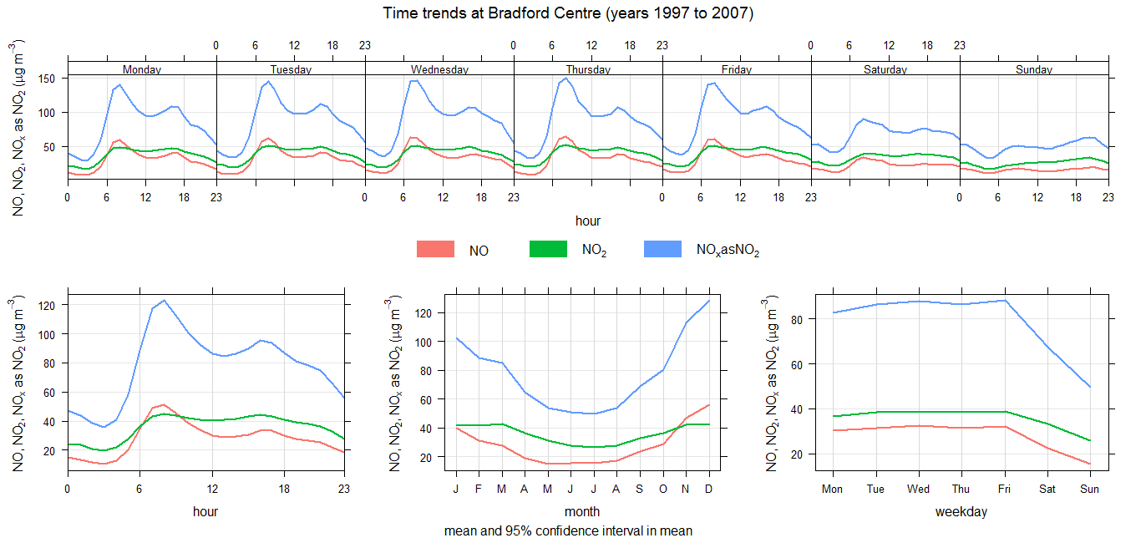
Monitoring stations data: 4 studies
1
2
Cancels out any seasonal variations and any peaks as long-term averages were always used!
Poor spatial distribution and usually few road-side monitoring
Discrepancy between subjects residential/ school locations and locations of monitoring stations
Notes:
Pictures courtesy of 1. http://www.geograph.org.uk/photo/1295381
2: Daily, weekly and annual trends of NOx at Bradford centre, data source: (DEFRA data archive)

Slide 29
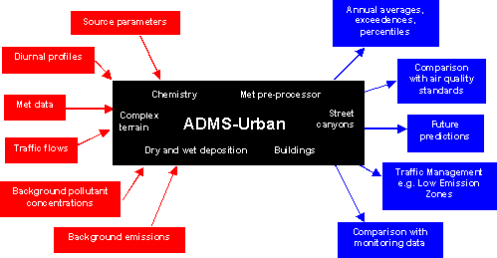
Dispersion modelling: 4 studies
Severe data demands
At the mercy of the emission factors used in the model
Overestimates pollution during periods of calm wind
1
Notes:
Pictures courtesy of 1. http://www.cerc.co.uk/environmental-software/ADMS-Urban-model.html
Can systematically underestimate air pollution at the road side (an emission factors problem!)
Finally, one study used NO2 monitoring, 1 traffic intensity within 100 meters of the residence, 1 group of GIS data

Slide 30
Pollutants studied

Slide 31
Pollutants studied
Exposure assessment method | Pollutants investigated
Land-use regression models | _ | NO₂ | PM_{2.5} | _ | Soot | _ | _
Land-use regression models | _ | NO₂ | PM_{2.5} | _ | Soot | _ | _
Land-use regression models | _ | NO₂ | PM_{2.5} | _ | Soot | NO | _
Land-use regression models, proximity to roads, regulatory monitoring data | CO | NO₂ | PM_{2.5} | PM₁₀ | Soot | NO | _
Land-use regression models | _ | NO₂ | PM_{2.5} | _ | Soot | _ | _
Dispersion modelling | _ | _ | _ | PM₁₀ | _ | _ | NO_{x}
NO2 monitoring | _ | NO₂ | _ | _ | _ | _ | _
Dispersion modelling, distance to the nearest road, regulatory monitoring data | _ | NO₂ | _ | _ | _ | _ | NO_{x}
Land-use regression model, distance to next major road | _ | NO₂ | PM_{2.5} | _ | Soot | _ | _
Dispersion modelling, traffic intensity within 100 m of the residence | _ | _ | _ | _ | _ | _ | NO_{x}
Dispersion modelling, distance to major roads | _ | NO₂ | _ | _ | _ | _ | _
Proximity to highway, a group of residential GIS data | _ | _ | _ | _ | _ | _ | _
Land-use regression model, proximity to the nearest high-traffic roads | _ | NO₂ | _ | _ | _ | _ | _
Regulatory monitoring data | _ | NO₂ | _ | _ | _ | _ | _
Regulatory monitoring data | _ | NO₂ | _ | PM₁₀ | _ | _ | _
Proximity to trunk roads | _ | _ | _ | _ | _ | _ | _
Number | 1 | 12 | 6 | 3 | 6 | 2 | 3

Slide 32
Measures of association

Slide 33
NO₂ measures of association
Exposure assessment method/ N | N of measures of association | Exposure associated with higher odds of onset | Ditto + statistically significant | NO₂ levels exceeding WHO guidelines? | Exposure associated with lower odds of onset | Ditto + statistically significant | Increase interval in exposure (µg/m³)
Land-use regression/ 7 | 17 | 16 | 4 | No | 1 | 0 | 10.3, 10.6, 7.2, 10, 10.4, 9, 10
Dispersion modelling/ 1 | 4 | 1 | 0 | Yes and No | 3 | 0 | 19.6, 27.3
Central monitoring/ 2 | 3 | 3 | 2 | NA | 0 | 0 | 18.8, 24.1
Diffusion tube monitoring/ 1 | 15 | 15 | 9 | NA | 0 | 0 | 11.6
39
35

Slide 34
PM_{2.5} measures of association
Exposure assessment method/ N | N of measures of association | Exposure associated with higher odds of onset | Ditto + statistically significant | PM_{2.5} levels exceeding WHO guidelines? | Exposure associated with lower odds of onset | Ditto + statistically significant | Increase interval in exposure (µg/m³)
Land-use regression/ 5 | 14 | 14 | 7 | Yes | 0 | 0 | 3.2, 3.3, 4.1, 1, 3.2
Central monitoring/ 1 | 2 | 2 | 0 | Yes | 0 | 0 | 9.7
16
16

Slide 35
Black carbon measures of association
Exposure assessment method/ N | N of measures of association | Exposure associated with higher odds of asthma onset | Ditto + statistically significant | BC levels exceeding WHO guideline? | Exposure associated with lower odds of asthma onset | Ditto + statistically significant | Increase interval in exposure (10⁻⁵/ m)
Land-use regression/ 6 | 16 | 16 | 5 | No guideline | 0 | 0 | 0.54, 0.58, 1.2, 1, 0.57, 0.5
16
16

Slide 36
Magnitude of risk estimates
NO₂ | 1.24 (1.03-1.49 ) | PM_{2.5} | Soot
0.78 (0.62-0.98) | 1.26 (1.00-1.58) | 1.20 (0.95-1.5) | 1.03 (0.67-1.59)
0.82 (0.67-1.02) | 1.26 (1.00-1.58) | 1.01 (0.99-1.03) | 1.06 (0.90-1.24)
0.82 (0.67-1.02) | 1.26 (1.02-1.55) | 1.08 (0.90-1.30) | 1.10 (0.50-2.50)
0.95 (0.59-1.52) | 1.27 (1.03-1.57) | 1.12 (0.84-1.50) | 1.10 (0.70-1.90)
1.03 (0.86-1.23) | 1.27 (1.03-1.57) | 1.15 (0.82-1.62) | 1.12 (0.88-1.43)
1.04 (0.89-1.22) | 1.28 (1.00-1.64) | 1.20 (0.98-1.48) | 1.12 (0.94 -1.34 )
1.05 (0.64-1.72) | 1.28 (1.04-1.56) | 1.28 (1.10-1.49) | 1.13 (0.94-1.38)
1.086 (0.78-1.52) | 1.29 (0.99-1.69) | 1.30 (0.66-2.56) | 1.14 (1.14-1.29)
1.10 (0.91-1.33) | 1.29 (1.06-1.51) | 1.32 (0.96-1.83) | 1.15 (0.85-1.55)
1.12 (0.84-1.49) | 1.29 (1.07-1.56) | 1.32 (1.04-1.69) | 1.16 (0.87-1.54)
1.13 (1.04-1.23) | 1.29 (1.07-1.56) | 1.36 (1.09-1.69) | 1.20 (0.60-2.30)
1.14 (0.95-1.41) | 1.29 (1.11-1.49) | 1.38 (1.03-1.61) | 1.21 (1.06-1.38 )
1.14 (0.97-1.34 ) | 1.29 (1.11-1.49) | 1.66 (0.91-3.05) | 1.26 (1.02-1.56)
1.17 (0.86-1.58) | 1.3 (0.60-2.9) | 2.10 (0.6-7.1) | 1.28 (1.02-1.59)
1.17 (0.98-1.41) | 1.37 (0.69-2.71) | 3.1 (1.30-7.4) | 1.30 (0.98-1.71)
1.18 (0.93-1.51) | 1.5 (0.9-2.5) | 4.1 (1.2-13.8) | 1.32 (1.09-1.60)
1.19 (1.05-1.34 ) | 1.9 (0.9-4.0) |  | Elevated and significant
1.21 (0.89-1.65) | 2.10 (1.10-4.75) |  | Elevated but insignificant
1.22 (1.04-1.45) | 2.17 (1.18-4.00) | _ | Reduced but insignificant
Notes:
In practice, the 95% CI is often used as a proxy for the presence of statistical significance if it does not overlap the null value (e.g. OR=1). Nevertheless, it would be inappropriate to interpret an OR with 95% CI that spans the null value as indicating evidence for lack of association between the exposure and outcome.

Slide 37
Further observations

Slide 38
Other observations
Risk estimates were larger for girls (Shima & Adachi 2000, Shima et al. 2003, Oftedal et al. 2009, Clark et al. 2010)
Positive associations with traffic-related air pollution were larger for non-allergic asthma (Gehring et al. 2010, Gruzieva et al. 2013)
Positive associations with NO₂ winter-fall exposures were larger than with NO₂ summer exposures (Jerret et al., 2008)
Non-movers had higher and significant risk estimates when compared to movers (Gehring et al., 2010)
Avoidance of house dust mites, pet allergens, environmental tobacco smoke and encouragement of breast feeding protected against the effect of air pollution (Carlsten et al., 2010)

Slide 39
Should we believe the results?

Slide 40
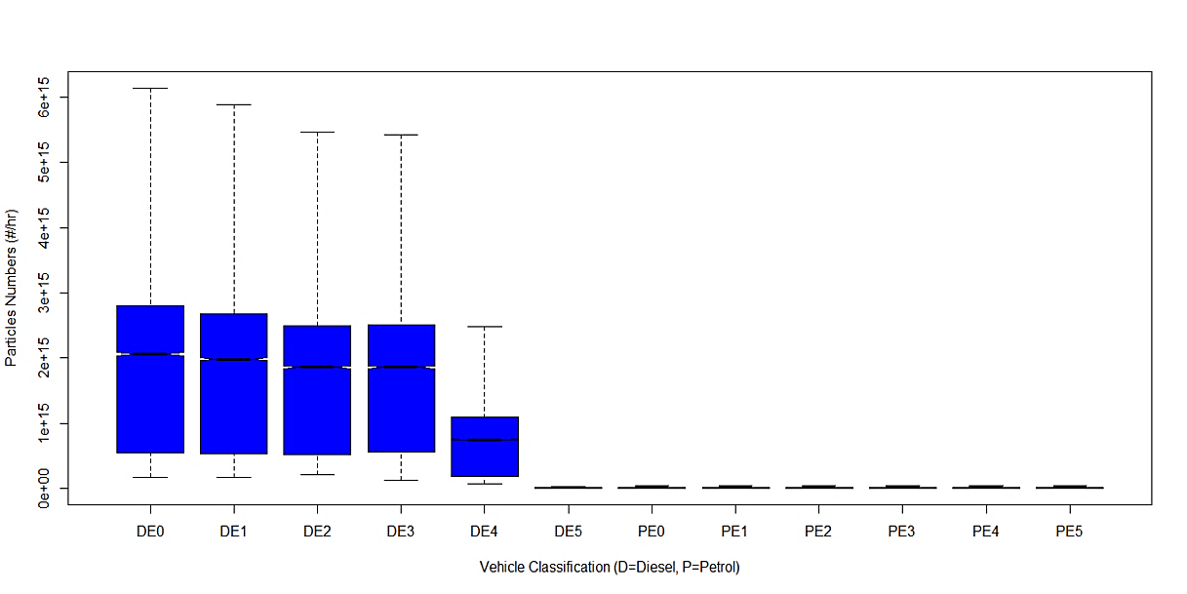
Synthesis with other knowledge
Indoor NO₂ not associated with the onset of asthma (Shima and Adachi 2000, Shima et al. 2002, Gauderman et al. 2005, Casas et al. 2012)
NO₂ may be acting as a surrogate of another pollutant/ mixture
Ultra-fine particles (UFPs) are correlated with levels of NO₂ and NOx (Harrison 2005, Yahaya et al. 2012)
UFPs offer a plausible link for a causal interpretation of these results (Li et al. 2003, Xie and Wenzel 2013, Health Effects Institute 2013)

Slide 41
Synthesis with other knowledge
Indoor NO₂ not associated with the onset of asthma (Shima and Adachi 2000, Shima et al. 2002, Gauderman et al. 2005, Casas et al. 2012)
NO₂ may be acting as a surrogate of another pollutant/ mixture
Ultra-fine particles (UFPs) are correlated with levels of NO₂ and NOx (Harrison 2005, Yahaya et al. 2012)
UFPs offer a plausible link for a causal interpretation of these results (Li et al. 2003, Xie and Wenzel 2013, Health Effects Institute 2013)
PM_{2.5} may be more potent than NO₂ in asthma initiation
But are the measures of associations real or spurious?
Less is known about black carbon, could be a suitable metric
PM the only pollutant regulated without regard to chemical form (Bell, 2009)

Slide 42
Synthesis with other knowledge
Relative Particle Number, Mass, Black Carbon, CO Concentration versus Downwind Distance from a freeway, source: (Zhu et al. 2002)
Notes:
NO2 can feasibly be measured at a large number of locations, and it has been widely used as a proxy for the mixture of traffic-related pollutants
Incidence of asthma tended to increase in locales with high concentrations of NO2
An expert panel reviewed the biological plausibility of epidemiological findings on criteria pollutants. Taking into account findings from epidemiological, human clinical, and toxicological studies, the experts concluded that NO2 may be acting as a surrogate for a mixture of pollutants
PM2.5 predictions from land-use regression models are less reliable

Slide 43
Conclusions
Heterogeneous studies report rather consistent associations
Results are likely to be due to chance, bias or confounding?
Risk estimates differ by exposure metric and pollutants
The nonsignificant results may be due to reduced power
Although the risk estimates tend to be low, the population attributable risk may be significant
Exposure assessment methods continue to be a limitation
Temporal variation and repeated exposures to short-term peaks always lost through averaging of exposure – are they important?
Many questions are left open

Slide 44
Future work

Slide 45
There is a need for integrating advanced exposure modelling with adequately large longitudinal studies, which can offer more robust definitions of children’s asthma
Notes:
How to move things forward

Slide 46
Future work
Regulatory
action
Compliance,
effectiveness
Emissions
Atmospheric transport,
chemical transformation,
and deposition
Ambient air quality
Human time-activity in relation to indoor and outdoor air quality; Uptake, deposition, clearance, retention
Exposure/
dose
Susceptibility factors;
mechanisms of damage
and repair, health outcomes
Human health
Chain of accountability (Health Effects Institute, 2003)

Slide 47
Future work
Regulatory
action
Compliance,
effectiveness
Emissions
Atmospheric transport,
chemical transformation,
and deposition
Dispersion Modelling
Human time-activity in relation to indoor and outdoor air quality; Uptake, deposition, clearance, retention
Exposure/
dose
Susceptibility factors;
mechanisms of damage
and repair, health outcomes
Human health
Human health
Chain of accountability (Health Effects Institute, 2003)

Slide 48
Future work
Regulatory
action
Compliance,
effectiveness
Emissions
Atmospheric transport,
chemical transformation,
and deposition
Dispersion Modelling
Human time-activity in relation to indoor and outdoor air quality; Uptake, deposition, clearance, retention
Exposure/
dose
Susceptibility factors;
mechanisms of damage
and repair, health outcomes
Human health
Human health
Chain of accountability (Health Effects Institute, 2003)

Slide 49
Notes:
There is also a need for more robust definitions and categorization of asthma which may provide mechanistic explanations for how some of these effects may occur
PHEM only predicts tail pipe emissions for PM

Slide 51
Future work
Regulatory
action
Compliance,
effectiveness
Emissions
Atmospheric transport,
chemical transformation,
and deposition
Dispersion Modelling
Human time-activity in relation to indoor and outdoor air quality; Uptake, deposition, clearance, retention
Exposure/
dose
Susceptibility factors;
mechanisms of damage
and repair, health outcomes
Human health
Chain of accountability (Health Effects Institute, 2003)

Slide 52
Future work
Bradford Institute for Health Research
Notes:
Pictures 1:https://www.bradfordcollege.ac.uk/news/2013/born-bradford-comes-college-festival-talk-811
2: http://www.borninbradford.nhs.uk/parents-families/the-bib-film-photography-and-poetry-gallery/photo-gallery/significant-numbers/
3: http://www.bradfordresearch.nhs.uk/

Slide 53
Future work
Regulatory
action
Compliance,
effectiveness
Emissions
Atmospheric transport,
chemical transformation,
and deposition
Dispersion Modelling
Human time-activity in relation to indoor and outdoor air quality; Uptake, deposition, clearance, retention
Exposure/
dose
Susceptibility factors;
mechanisms of damage
and repair, health outcomes
Human health
Chain of accountability (Health Effects Institute, 2003)

Slide 54
Acknowledgments
Professor Khair Jadaan
Dr Qais Banihani
Dr Karl Ropkins

Slide 55
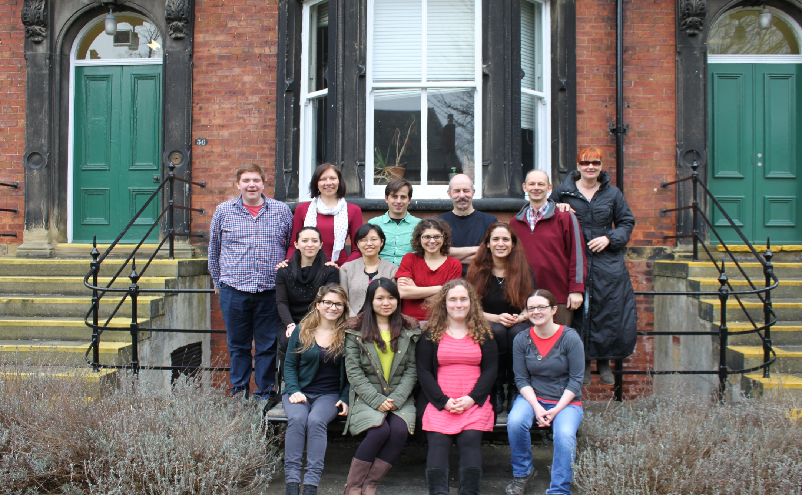
Acknowledgments

Slide 56
References
Anderson, H. Ross, Ramyani Gupta, David P. Strachan, and Elizabeth S. Limb. "50 years of asthma: UK trends from 1955 to 2004." Thorax 62, no. 1 (2007): 85-90.
Anderson, H. Ross. "Air pollution and trends in asthma." In The rising trends in asthma, vol. 206, pp. 190-203. Wiley Chichester, 1997.
Assessing health impact of air quality regulations: Concepts and methods for accountability research. Health Effects Institute, 2003.
Beelen, Rob, Gerard Hoek, Danielle Vienneau, Marloes Eeftens, Konstantina Dimakopoulou, Xanthi Pedeli, Ming-Yi Tsai et al. "Development of NO 2 and NO x land use regression models for estimating air pollution exposure in 36 study areas in Europe–the ESCAPE project." Atmospheric Environment 72 (2013): 10-23.
Carlsten, Chris, Anne Dybuncio, Allan Becker, Moira Chan-Yeung, and Michael Brauer. "Traffic-related air pollution and incident asthma in a high-risk birth cohort." Occupational and environmental medicine (2010): oem-2010.
Casas, L., Tischer, C., Tiesler, C., Bruske, I., Koletzko, S., Bauer, C. P., Wichmann, H. E., von Berg, A., Berdel, D., Kramer, U., Schaaf, B., Lehmann, I., Herbarth, O., Heinrich, J., Giniplus and Group, L. I. S. (2012) 'Association of gas cooking with children's respiratory health: results from GINIplus and LISAplus birth cohort studies', Indoor Air, 22(6), 476-82.
CASP Checklists, Critical Appraisal Skills Programme (2014), available from: http://www.casp-uk.net/#!casp-tools-checklists/c18f8 Oxford.
Clark, N. A., Demers, P. A., Karr, C. J., Koehoorn, M., Lencar, C., Tamburic, L. and Brauer, M. (2010) 'Effect of early life exposure to air pollution on development of childhood asthma', Environmental Health Perspectives, 118(2), 284. Bell, L. M. (2009) 'Critical Issues of Exposure Assessment for Human Health Studies of Air Pollution ', [online], available: http://webcache.googleusercontent.com/search?q=cache:oGERjACtp1oJ:www.samsi.info/sites/default/files/BELL_Samsi_presentation.ppt+&cd=1&hl=en&ct=clnk&gl=uk [accessed 21 August 2014].
Cookson, William. "The immunogenetics of asthma and eczema: a new focus on the epithelium." Nature Reviews Immunology 4, no. 12 (2004): 978-988.
Gauderman, W. J., Avol, E., Lurmann, F., Kuenzli, N., Gilliland, F., Peters, J. and McConnell, R. (2005) 'Childhood asthma and exposure to traffic and nitrogen dioxide', Epidemiology, 16(6), 737-743.
Gehring, Ulrike, Alet H. Wijga, Michael Brauer, Paul Fischer, Johan C. de Jongste, Marjan Kerkhof, Marieke Oldenwening, Henriette A. Smit, and Bert Brunekreef. "Traffic-related air pollution and the development of asthma and allergies during the first 8 years of life." American journal of respiratory and critical care medicine 181, no. 6 (2010): 596-603.
Gruzieva, Olena, Anna Bergström, Olesya Hulchiy, Inger Kull, Tomas Lind, Erik Melén, Vitaliy Moskalenko, Göran Pershagen, and Tom Bellander. "Exposure to air pollution from traffic and childhood asthma until 12 years of age." Epidemiology 24, no. 1 (2013): 54-61.
Hansen, Susanne, Marin Strum, Ekaterina Maslova, Erik Lykke Mortensen, Charlotta Granström, and Sjurdur F. Olsen. "A comparison of three methods to measure asthma in epidemiologic studies: results from the Danish national birth cohort." PloS one 7, no. 5 (2012): e36328.

Slide 57
References
Harrison R. M., J. A. M. (2005) 'A Multi-Site Study of Particles Number Concentrations in Urban Areas', Environmental science & technology, 39(16), 6063- 6070.
Health Effects Institute, H. E. I. (2013) Understanding the Health Effects of Ambient Ultrafine Particles, HEI Perspectives 3, Boston, MA: Health Effects Institute.
Jerrett, Michael, Ketan Shankardass, Kiros Berhane, W. James Gauderman, Nino Künzli, Edward Avol, Frank Gilliland et al. "Traffic-related air pollution and asthma onset in children: a prospective cohort study with individual exposure measurement." Environ Health Perspect 116, no. 10 (2008): 1433-1438.
Khreis H, Kelly C, Tate J, Parslow R. Exposure to traffic-related air pollution and the development of childhood asthma. PROSPERO 2014:CRD42014015448, available from: http://www.crd.york.ac.uk/PROSPERO/display_record.asp?ID=CRD42014015448
Koenig, Jane Q. "Air pollution and asthma." Journal of allergy and clinical immunology 104, no. 4 (1999): 717-722.
Li, N., Sioutas, C., Cho, A., Schmitz, D., Misra, C., Sempf, J., Wang, M., Oberley, T., Froines, J. and Nel, A. (2003b) 'Ultrafine particulate pollutants induce oxidative stress and mitochondrial damage', Environmental Health Perspectives, 111(4), 455.
McConnell, Rob, MD. Professor of Preventive Medicine, USC, at Symposium on Cumulative Impacts and Children's Environmental Health 2013, available from: https://www.youtube.com/watch?v=15Qj_JsCdpM.
Oftedal, Bente, Wenche Nystad, Bert Brunekreef, and Per Nafstad. "Long-term traffic-related exposures and asthma onset in schoolchildren in oslo, norway." Environmental health perspectives 117, no. 5 (2009): 839-844.
Searl, Alison. "A Review of the Acute and Long-term Impacts of Exposure to Nitrogen Dioxide." IOM-Institute of Occupational Medicine Research Report TM/04/03, available at http://www. iom-world. org (2004).
Shima, Masayuki, and Motoaki Adachi. "Effect of outdoor and indoor nitrogen dioxide on respiratory symptoms in schoolchildren." International journal of epidemiology 29, no. 5 (2000): 862-870.
Shima, Masayuki, Yoshio Nitta, and Motoaki Adachi. "Traffic-related air pollution and respiratory symptoms in children living along trunk roads in Chiba Prefecture, Japan." Journal of epidemiology 13, no. 2 (2003): 108-119.
Tacconelli, Evelina. "Systematic reviews: CRD's guidance for undertaking reviews in health care." The Lancet Infectious Diseases 10, no. 4 (2010): 226.
Xie, M. and Wenzel, S. E. (2013) 'A global perspective in asthma: from phenotype to endotype', Chin Med J, 126, 166-174.
Yahaya, N. Z., Tate, J. E., Tight, M. R. and Ghazali, N. A. (2012) 'Particle Number Counts: Comparing urban roadside and background levels', in Better Air Quality, Hong Kong., 5-7th December 2012.
Zhu, Y., Hinds, W. C., Kim, S., Shen, S. and Sioutas, C. (2002) 'Study of ultrafine particles near a major highway with heavy-duty diesel traffic', Atmospheric Environment, 36(27), 4323-4335.

