Slide 1
Mental Models of Eco-Driving
Institute for Transport Studies
FACULTY OF ENVIRONMENT
Comparison of Driving Styles in a Simulator
Sanna Pampel
Samantha Jamson
Daryl Hibberd
Yvonne Barnard

Slide 2
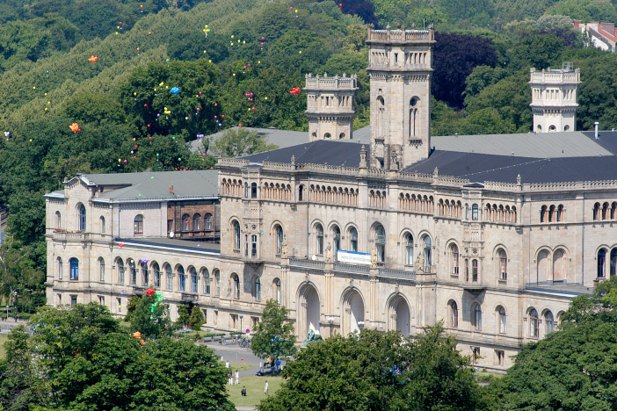

About me
Sanna Pampel
I studied Business and Economics Science in the Leibniz University of Hanover from 2003 to 2008
  Majored in Information Systems
  Dissertation about Mobile Tourist Guides
Photo: Courtesy of University of Hanover
Worked full-time in IT from 2008 to 2012, mostly on user interfaces for in-house applications
Began PhD in Transport Studies in November 2012
  First of three studies is completed and currently written up – the results are presented here

Slide 3
Content
1 Introduction
2 Effective Eco-Driving and Support Systems
3 Framework for Mental Models of Eco-Driving
3 Rationale and Hypotheses
4 Methodology
5 Results of Behavioural Data
6 Results of Verbal Data
7 Discussion and Conclusion

Slide 4
Introduction
Road transport is responsible for one fifth of the total carbon dioxide emissions in the EU (European Commission, 2014)
Eco-driving has the potential to reduce the emissions of the current vehicle fleet by 5 to 10% (Barkenbus, 2010)
Significant carbon dioxide reductions require large-scale behavioural changes
However, raising awareness and relying on monetary incentives are not enough (Delicado, 2012, Stillwater & Kurani, 2013)
There is a need to further understand drivers’ knowledge of and skills in eco-driving

Slide 5
Effective Eco-Driving and Support Systems
This study focusses on fuel savings
Money is initially a good motivator and appears in many drivers’ intentions and plans (Boriboonsomsin et al., 2010)
Feedback such as an MPG display seems to motivate actual behaviour changes, but drivers have problems choosing effective actions (Stillwater & Kurani, 2013)
Waters and Laker (1980) asked participants to drive in an eco-friendly manner around a specified course. The participants reduced their fuel consumption by 8% with lower speeds and higher gears.
People do have mental models of eco-driving that can be brought into use by prompting them

Slide 6
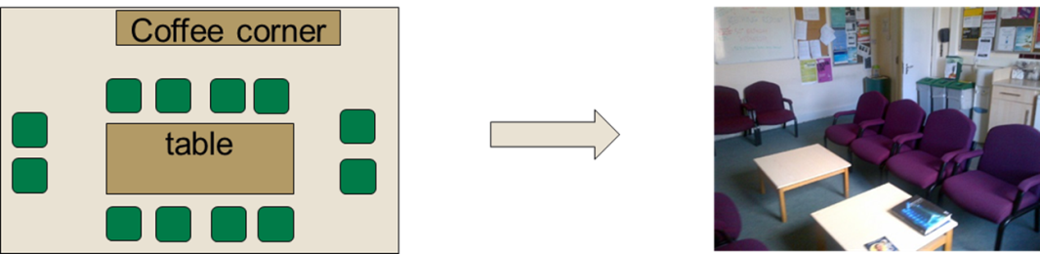
Framework for Mental Models of Eco-Driving
Mental models represent the reality in people’s minds (Johnson-Laird, 1988)
  They direct people’s perceptions and actions (Schank & Abelson, 1977)
  Mental models originate from education (Anderson, 1982), robotic (Johnson-Laird, 1988) and user-friendly design (Norman, 1983)
Mental Models are utilised to assess people’s knowledge and skills (e.g. Morgan et al., 2002; Vogt & Schaefer, 2012)
  They allow the exploration of cognitive processes that people are unable to access with introspection
Notes:
From field of learning and education

Slide 7
Framework for Mental Models of Eco-Driving
Mental models can be divided into three levels
The hierarchy allows for the assessment of learning and behaviours on different levels
The differentiation is not exact and may change with effort and training
Communication and Control with a Society of Mental Models, based on Rasmussen (1983) and adapted from Goodrich and Boer (1998)

Slide 8
Rationale and Hypotheses
This study aims to measure and represent drivers’ knowledge and skills of eco-driving
  It is attempted to measure the drivers’ behaviour and record some of their thoughts when they are asked to drive fuel efficiently
  The results can be used to improve drivers’ learning by providing them with more effective information and feedback
  EDSS can then address gaps and misconceptions in the drivers’ knowledge to maximise the effects of their efforts

Slide 9
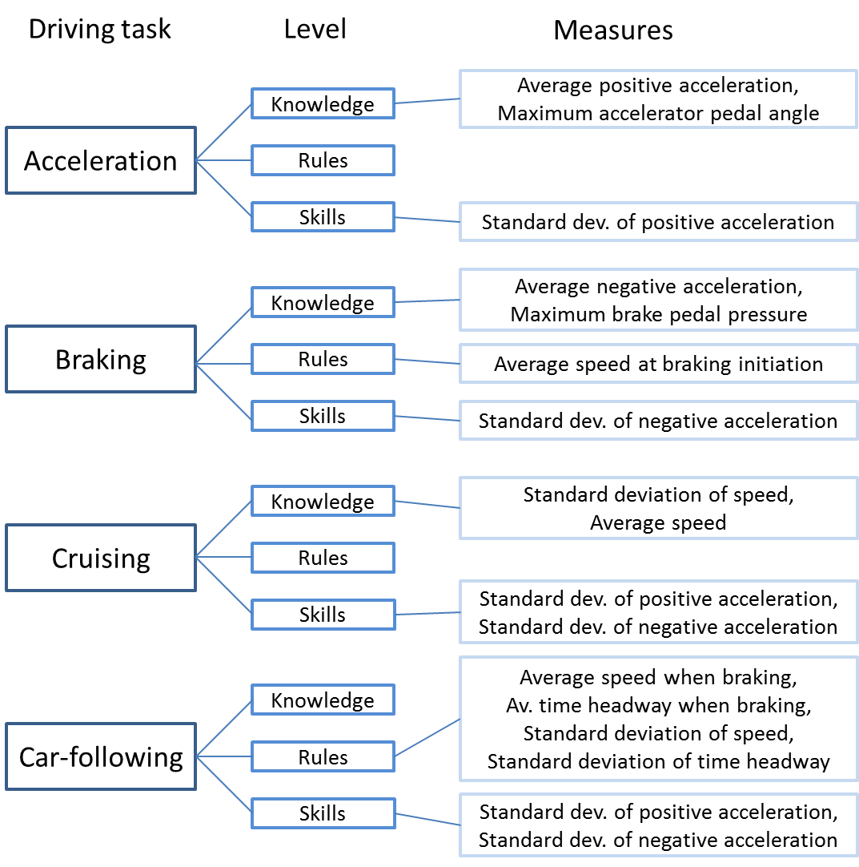
Rationale and Hypotheses
When asked to drive fuel efficiently, drivers should change their behaviour compared to driving in the baseline as well as safe conditions.
The drivers’ focus should change towards their own behaviour, away from the environment around them.
In addition, effects for Gender and the Order of instructions are tested

Slide 10
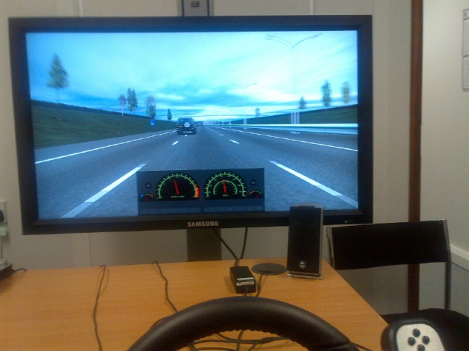
Methodology
16 regular drivers were recruited for an experiment with the desktop version (‘Baby Sim’) of the University of Leeds Driving Simulator
  Participants’ age between 26 and 43 years (mean: 33.8 years, SD: 5.7 years), 8 male (mean age: 37.0 years); 8 female (mean age: 30.6 years)
The driving simulator collected behavioural data
Voice was recorded
  Verbal protocols
  Open interviews
Notes:
Golden rules:
Anticipate traffic flow
Maintain a steady speed at low RPM
Shift up early
Check tyre pressures frequently at least once a month and before driving at high speed
Consider any extra energy required costs fuel and money

Slide 11
Methodology
Three-way (4x2x2) mixed design
  Within-subjects factor Instructions (4)
  Between subjects factors Gender (2) and Order of Instructions (2)
Sessions began with briefing, practise task and familiarisation drive
Sessions ended with debriefing and explanation of the study’s purpose
Simulator Drive | Safe-Eco Order | Eco-Safe Order
1 (urban & motorway) | “Drive normally.” (baseline1) | “Drive normally.” (baseline1)
2 (urban & motorway) | “Drive safely.” (safe) | “Drive fuel efficiently.” (eco)
3 (urban & motorway) | “Drive fuel efficiently.” (eco) | “Drive safely.” (safe)
4 (urban & motorway) | “Drive normally.” (baseline2) | “Drive normally.” (baseline2)
Notes:
Golden rules:
Anticipate traffic flow
Maintain a steady speed at low RPM
Shift up early
Check tyre pressures frequently at least once a month and before driving at high speed
Consider any extra energy required costs fuel and money

Slide 12
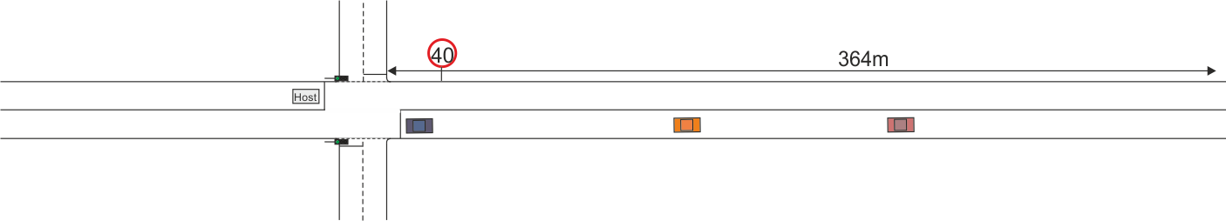

Methodology
Eco-Driving driving was tested for Acceleration and Braking…
Acceleration Scenario: Urban junction with lights turning from red to green
Braking Scenario: Approaching a junction with red traffic lights

Slide 13
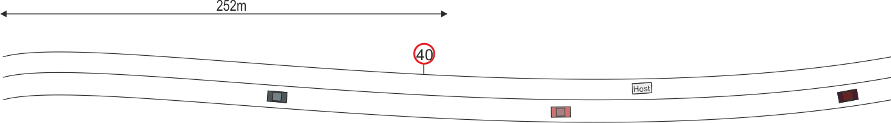
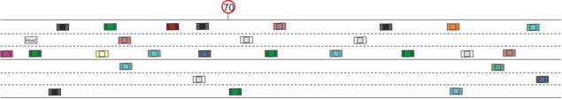
Methodology
… as well as for Cruising and Car-following
Cruising Scenario: Urban, slightly curvy road without junction
Car-following Scenario: Motorway with busy traffic

Slide 14
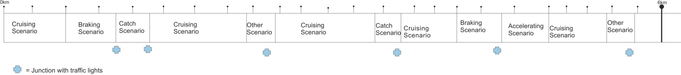
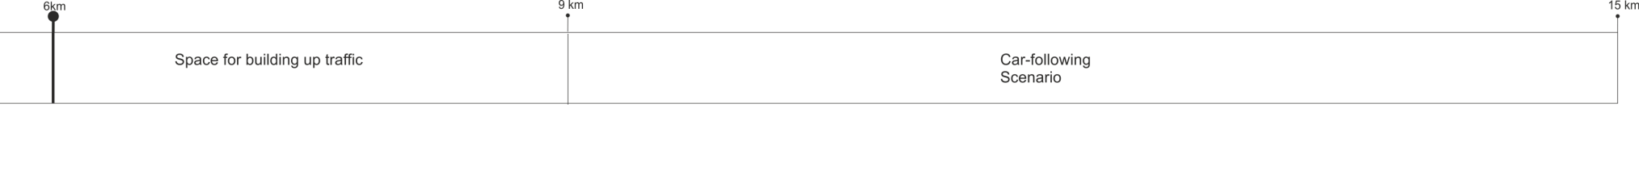
Methodology
Every Set of Drives included all four Scenarios
Example of an Urban Section with Acceleration, Braking and Cruising Scenarios
Motorway Section with Car-following Scenario

Slide 15
Results of Behavioural Data
Acceleration Scenario:
The maximum accelerator pedal angle is lower for eco-driving compared to the baseline drives:
F(3,36) = 6.314, p = .001, partial eta squared = .345
The standard deviation of positive acceleration is lower for eco-driving compared to the safe drive:
F(3,36) = 4.466, p = .009, partial eta squared = .271
 | Baseline 1 | Safe | Eco | Baseline 2
Mean (°) | 48.75 | 44.06 | 27.31 | 47.06
SE (°) | 5.45 | 6.27 | 2.28 | 5.92
 | Baseline 1 | Safe | Eco | Baseline 2
Mean (m/s²) | 0.90 | 0.91 | 0.70 | 0.94
SE (m/s²) | 0.05 | 0.05 | 0.05 | 0.06

Slide 16
Results of Behavioural Data
Braking Scenario:
The average negative acceleration is lower for eco-driving compared to the baseline and safe drives:
[F(1.748,20.970) = 9.086, p = .002, partial eta squared = .431]
Women (mean = 157.00N, SE = 12.56N) had higher maximum brake pressure than men [mean = 105.69N, SE = 12.56N, F(1,12) = 6.378, p = .027, r = .347]
 | Baseline 1 | Safe | Eco | Baseline 2
Mean (m/s²) | -0.72 | -0.68 | -0.56 | -0.72
SE (m/s²) | 0.03 | 0.04 | 0.03 | 0.05

Slide 17
Results of Behavioural Data
Cruising Scenario:
The average speed is lower for eco-driving compared to the baseline and safe drives.
F(3,36) = 18.038, p < .001, partial eta squared = .601
The standard deviation of positive acceleration is lower for eco-driving compared to the baseline and safe drives.
F(3,36) = 7.941, p < .001, partial eta squared = .398
 | Baseline 1 | Safe | Eco | Baseline 2
Mean (mph) | 39.88 | 39.23 | 37.13 | 40.14
SE (mph) | 0.41 | 0.53 | 0.50 | 0.56
 | Baseline 1 | Safe | Eco | Baseline 2
Mean (m/s²) | 0.39 | 0.36 | 0.28 | 0.41
SE (m/s²) | 0.02 | 0.02 | 0.02 | 0.03

Slide 18
Results of Behavioural Data
Car-following Scenario:
The standard deviation of positive acceleration is lower for eco-driving compared to the baseline drives.
F(3,36) = 10.891, p < .001, partial eta squared = .476
The standard deviation of negative acceleration is lower for eco-driving compared to the baseline (1) drive.
Wilcoxon signed-rank test, p = .010
Standard deviation of negative acceleration in the eco drive is significantly higher for women (mean = -.19 m/s², SE = .046 m/s²) than for men (mean = -.11 m/s², SE = .008 m/s², p = .015).
 | Baseline 1 | Safe | Eco | Baseline 2
Mean (m/s²) | 0.39 | 0.31 | 0.25 | 0.35
SE (m/s²) | 0.03 | 0.02 | 0.03 | 0.02
 | Baseline 1 | Safe | Eco | Baseline 2
Mean (m/s²) | 0.30 | 0.22 | 0.15 | 0.21
SE (m/s²) | 0.08 | 0.05 | 0.03 | 0.03

Slide 19
Results of Verbal Data
Some General Points:
All verbal recordings were transcribed and coded into nodes, forming higher level categories
The categories differ a lot from participant to participant, but some observations could be made
ECO-DRIVING Category:
Acceleration Scenario:
“So really take my time going up to sixty” (male, 39 y.)
“This time no hard acceleration” “I did not accelerate as hard” (male, 37 y.)
Cruising Scenario:
“I kind of kept the a constant speed as much as I could” (male, 39 y.)
“tried not to go as fast
So I kept it down towards thirty;
Watched the revs” (male, 37 y.)
“My car seems to like between sixty to seventy” (male, 40 y.)
Braking Scenario:
“Which means I just take my foot off the gas, because a see a red light overhead; and that to me is more fuel efficient” (female, 27 y.)
“I have been reading somewhere that this is free petrol, coasting. Don’t know how true it is” (male, 37 y.)

Slide 20
Results of Verbal Data
ACTION Category:
Contains every statement about the participants’ own actions, summing up to 1414 references
Largest subnodes are speed maintenance (799 references) and speed decrease (506 references)
The percentage of verbal protocols coded in ACTION is higher for eco-driving compared to the safe drive.
F(3,33) = 3.423, p = .028, partial eta squared = .237
 | Baseline 1 | Safe | Eco | Baseline 2
Mean | 0.29 | 0.28 | 0.35 | 0.27
SE | 0.02 | 0.02 | 0.03 | 0.03

Slide 21
Results of Verbal Data
ENVIRONMENT Category:
Contains all statements about anything in the world around the participant in the simulator (1539 references)
The largest sub-node is road users (880 references); other sub-nodes are events, road and road features, traffic lights and landscape
The percentage of verbal protocols coded in ENVIRONMENT is lower for eco-driving compared to the safe drive.
F(3,33) = 2.967, p = .046, partial eta squared = .212
 | Baseline 1 | Safe | Eco | Baseline 2
Mean | 0.41 | 0.42 | 0.32 | 0.43
SE | 0.04 | 0.04 | 0.05 | 0.06

Slide 22
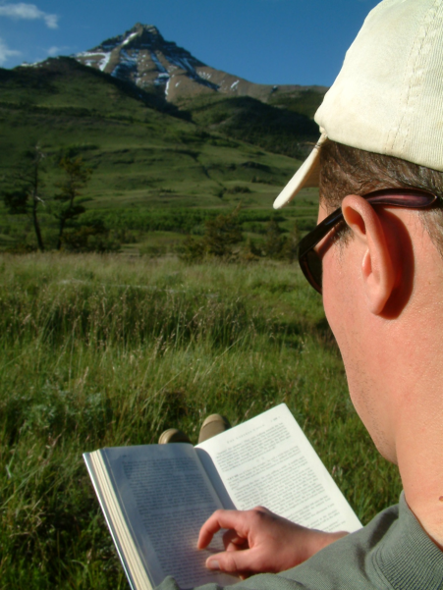
Discussion and Conclusion
Knowledge:
  Behaviour changes when people were asked to drive eco-friendly.
  Eco-driving behaviour does not only differ from ‘normal’, but also from ‘safe’ driving.
  Speed were slower than for safe driving, although slower speeds are known to be safer (Taylor et al., 2000).
© Muriel Lasure | Dreamstime Stock Photos
  Less steep acceleration/deceleration during eco-driving, but some drivers already drove slower into the braking scenario
  It could not be shown that speed was more constant during eco-driving, although some drivers mentioned a constant speed as their eco-driving strategy

Slide 23
Discussion and Conclusion
Rules:
  No significant results for the rule-based behaviours
Skills:
  Smoother pedal actions during eco-driving compared to safe driving in the acceleration scenario
  No such effect in the braking scenario
  During cruising and motorway driving pedal actions were smoother for eco- than for normal driving

Slide 24
Discussion and Conclusion
Between-subjects:
  Some Gender effects for brake pedal pressure and SD of negative acceleration
  Effects have not yet occurred in the literature and could be attributed to pedals of desktop simulator
  Results by Graving et al. (2010) could not be supported
  Whether or not the safe run was placed before the eco run had no effect on the eco run

Slide 25
Discussion and Conclusion
Verbal Protocols and Interviews:
  The drivers had a stronger focus on their own actions during eco-driving than during safe driving
  The focus on the environment around the drivers was lower for eco- than for safe driving
  The participants made several statements about eco-driving – at different degrees of correctness and effectiveness – and actual behavioural execution

Slide 26
Discussion and Conclusion
Limitations:
  Desktop simulator with sensitive pedals and steering wheel
  No rear view mirrors, so difficult to consider possible traffic behind participant vehicle
  Absence of traffic in participants’ lane in urban/rural roads, and generally fewer hazards than in the real world
  Requirement to stay in middle lane on the motorway

Slide 27
Discussion and Conclusion
Fuel-consumption model could help with evaluation of eco-driving performance
Future studies with larger samples and more realistic driving conditions
  Can lead to typology of ‘eco-drivers’
Results useful for design of EDSS

Slide 28
Thank you for your attention!
Contact:
Sanna Pampel
Postgraduate Research Student
Institute for Transport Studies
University of Leeds
+44 (0)113 34 31797
tssmp@leeds.ac.uk

