Slide 1
Are highway designers and transport planners offering ‘equal service’ to disabled people? How can we ensure that the highways meet the current and future needs of those with a mobility impairment?

Slide 2
Sustainable communities meet the diverse needs of existing and future residents, are sensitive to their environment by minimising their effect on climate change, and contribute to a high quality of life. They are safe and inclusive, well planned and promote social inclusion, offering equality of opportunity and good services for all.
Notes:
Social model of disability. Equality Duty.

Slide 3
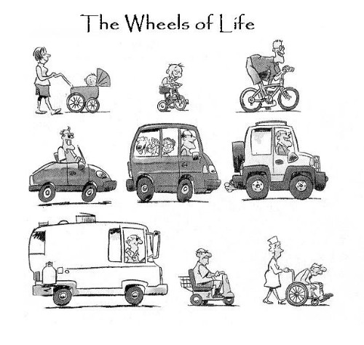
Is disabled access a ‘minority issue’?
The 2001 Census indicates that of the 715,402 people living in the Leeds Metropolitan Area, almost 18% - have a long term limiting illness and 57,731 of those are of working age.
163,506 are aged over 60
We are all going to age…

Slide 4
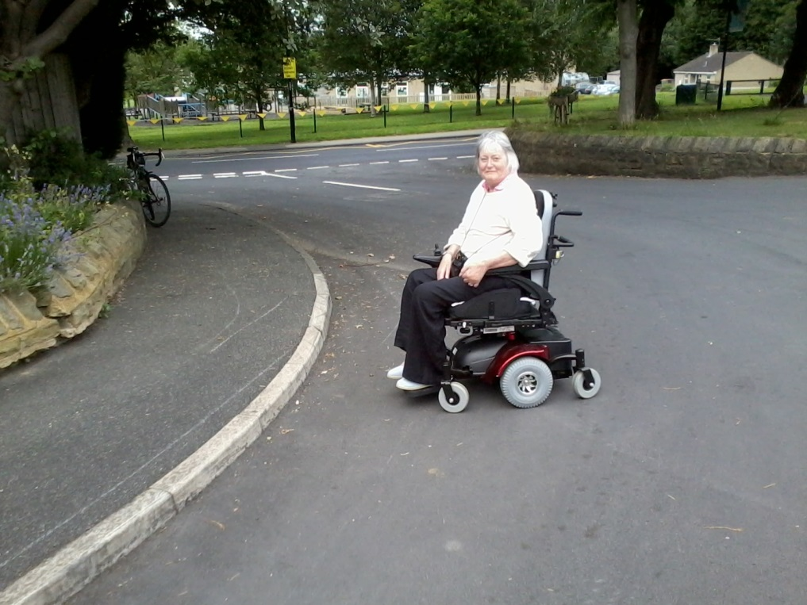
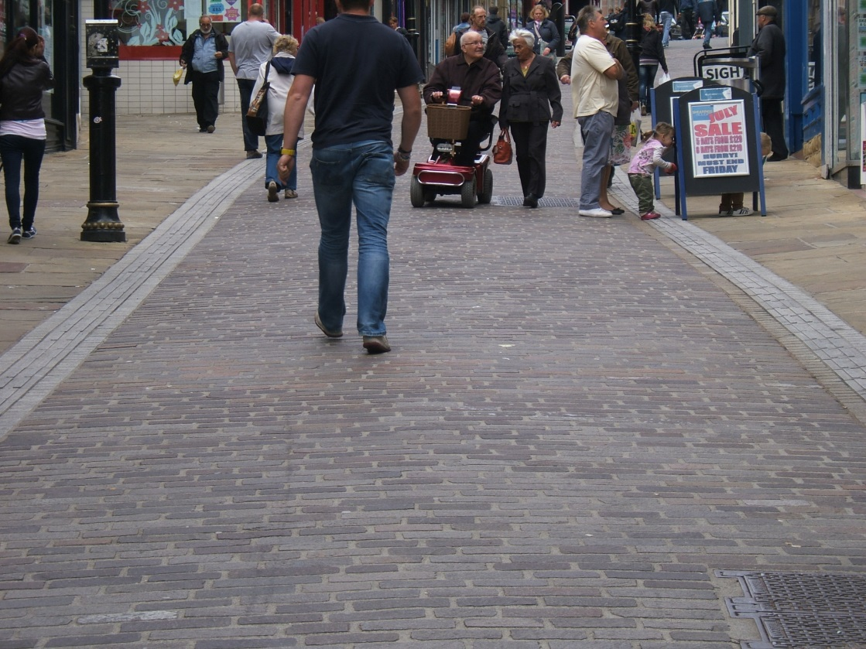
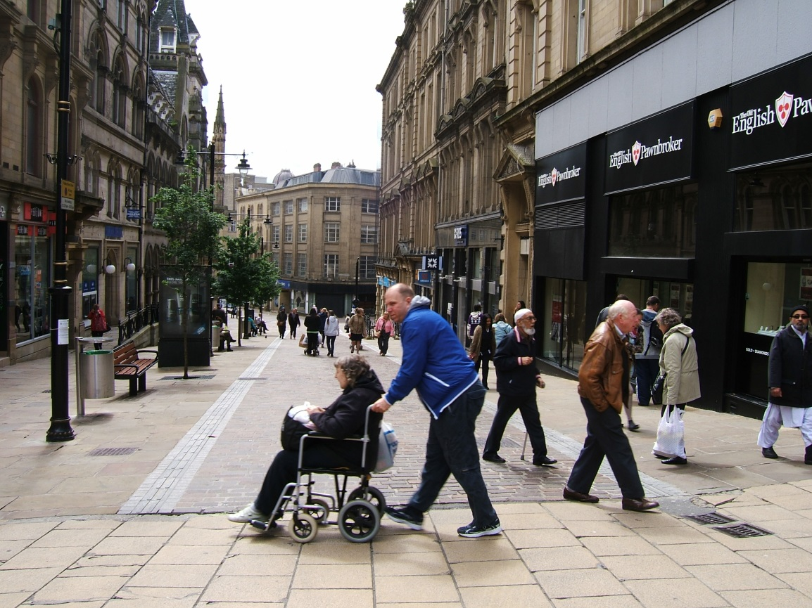
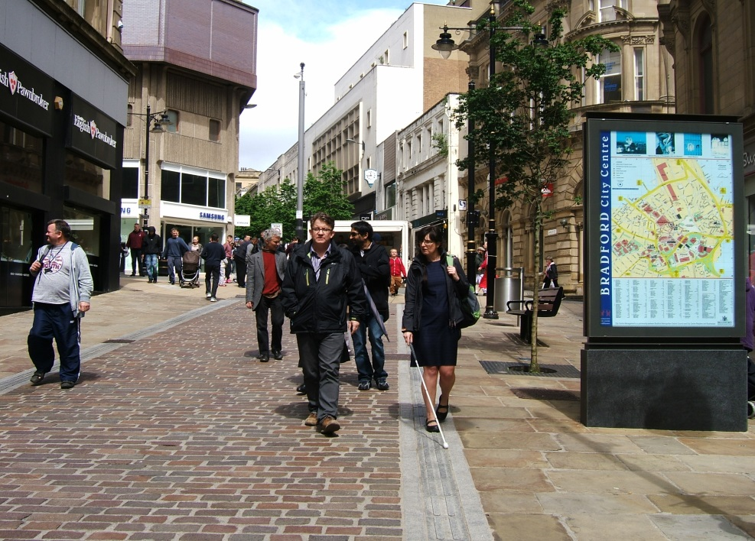
So what is this all about…

Slide 5
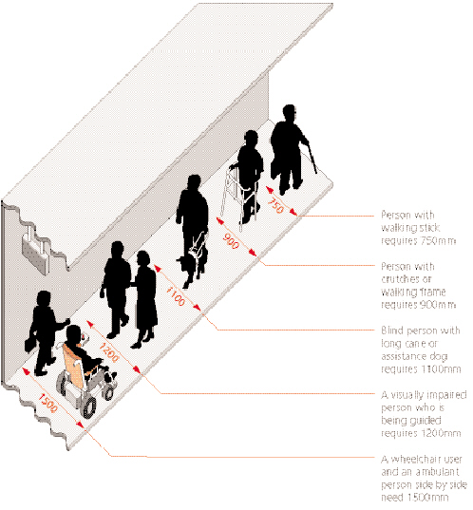
The way streets are laid out and how they relate to surrounding buildings and spaces has a great impact on the aesthetic and functional success of a neighbourhood. Certain elements are critical because once laid down they cannot easily be changed. These issues are considered in the masterplanning and design coding stage, and need to be resolved before detailed design is carried out.
Manual for Streets
http://goo.gl/maps/L1Ent
Source: DfT Inclusive Mobility
Notes:
So by making improvements to accessibility, we are creating a better environment for everyone – parents with buggies and people with luggage benefit from dropped kerbs and all pedestrians benefit from a wider footway. Needs of blind and partially sighted people are met by the provision of tactile paving, although some older people find tactiles uncomfortable to walk on.

Slide 6
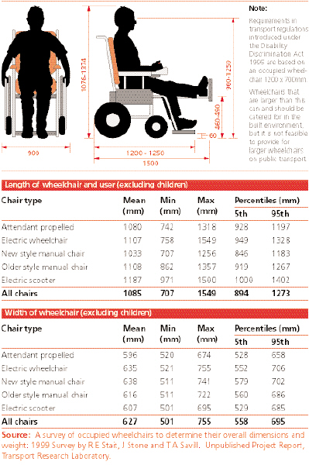
Manoeuvring around obstacles…
Manoeuvring space is needed for a wheelchair to turn corners or turn around. Skilled users of manual wheelchairs can turn through 360°° in a space no more than 1500mm x 1500mm, but this is insufficient for larger chairs, particularly outdoor electric wheelchairs (turning circle 2420mm), electric pavement vehicles (turning circle 4350mm) and for wheelchair users with extended leg rests
Notes:
Implications for the positioning of dropped kerbs, and for width of refuges.

Slide 7
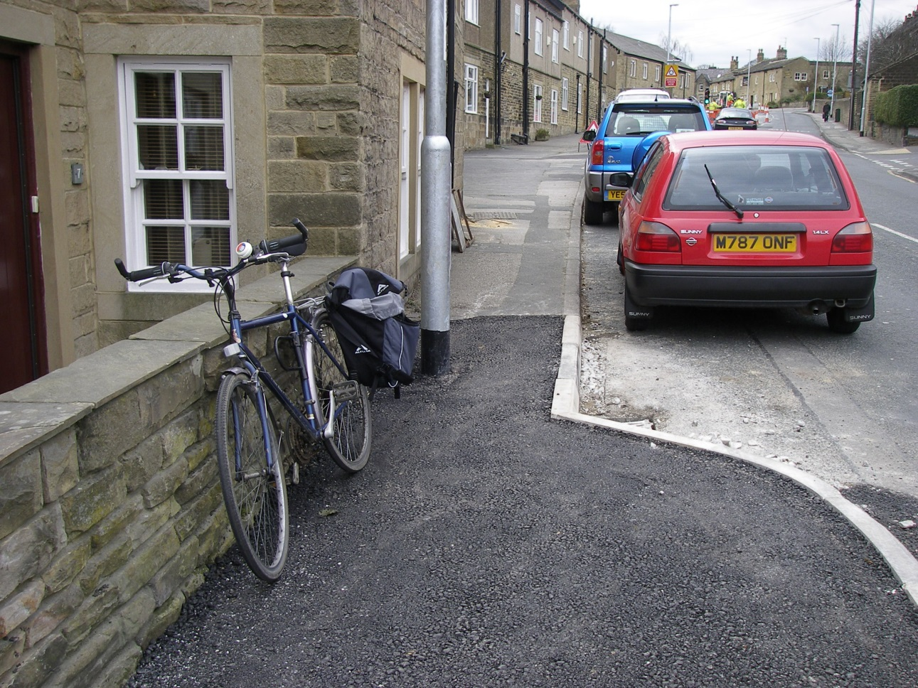
Key guidance
Preferred footway width 2000mm, rising to 4000mm in busy pedestrian areas, min recommended width 1500mm, allowing a wheelchair user and an ambulant pedestrian to pass, and for a mobility impaired person to walk with a companion. Critically, there should be no pinchpoints where the available footway width falls below 1000mm.

Slide 8
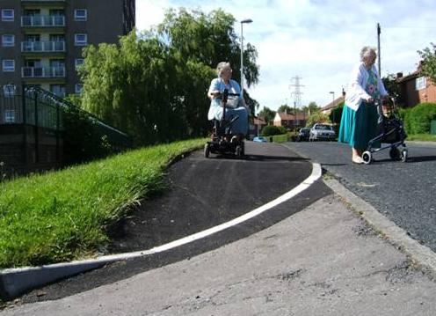
Gradient and crossfall
Inclusive Mobility states that gradients should not exceed 8% (recommended standard 5%) and crossfall should be not greater than 2.5%, preferably at 1%.
http://goo.gl/maps/Juzo6
This includes the crossfall designed in for drainage, but additional crossfall will be created by introduction of vehicular accesses and accessible dropped crossings.

Slide 9
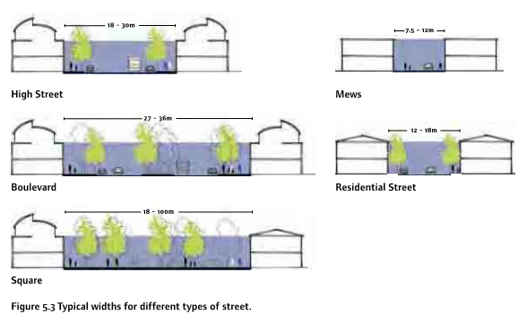
In terms of streetscape, a wide carriageway with tight, enclosed corners makes a better junction than cutback corners with a sweeping curve. This might involve bringing buildings forward to the corner.

Slide 10
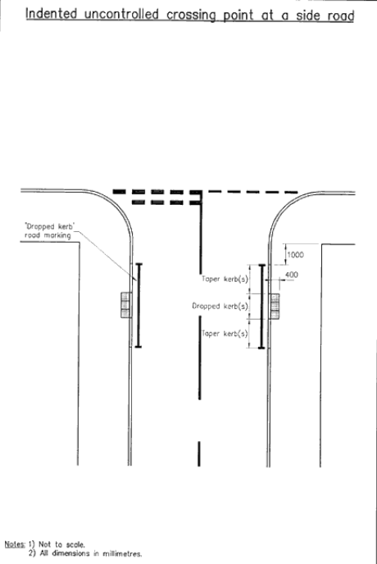
http://goo.gl/maps/w4EQC
Bearing in mind the guidance with regards to gradient and crossfall... It is recommended that there is 900mm level space beyond the are of the dropped kerb to allow straight passage for wheelchair users and other pedestrians with a mobility impairment. The height of the kerb is likely to be 100-120mm, so you would need 1200mm to 1500mm to form an acceptable ramp. The guidance cannot be applied verbatim to streets where the footway is below 2.5m, even in perfectly flat areas.
Notes:
Needs of blind/ partially sighted pedestrians in terms of radius.

Slide 12
Notes:
Is lowered kerb height an answer? Research into effective kerb height.

Slide 14
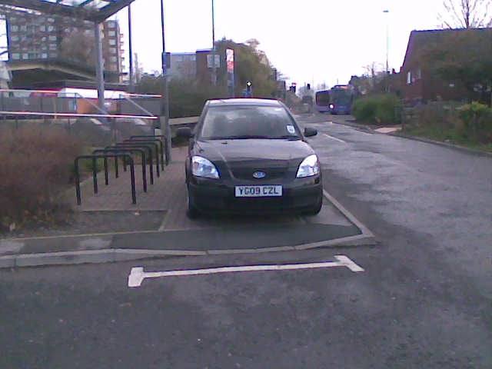

Slide 15
Specific tactile layouts have been developed and tested to compensate for the lack of kerb upstand, and to convey other information to blind and partially sighted pedestrians. However, the junction layout may make application difficult, as can certain types of crossings, for example speed tables.
Provision of shared use facilities, for example around Toucan crossings, also creates challenges in the application of tactile information.
Notes:
Detectability issues. Parkin and Smithies (2012)
found a similar result with only 16% (n 5 3) of questionnaire
respondents who were blind saying that they found tactile
paving helpful.
Lack of awareness of different layouts due to limited availability of mobility training.

Slide 18
‘It is recommended that the movement framework for a new development be based on the user hierarchy[…] Applying the hierarchy will lead to a design that increases the attractiveness of walking, cycling and the use of public transport’. Manual for Streets

Slide 19
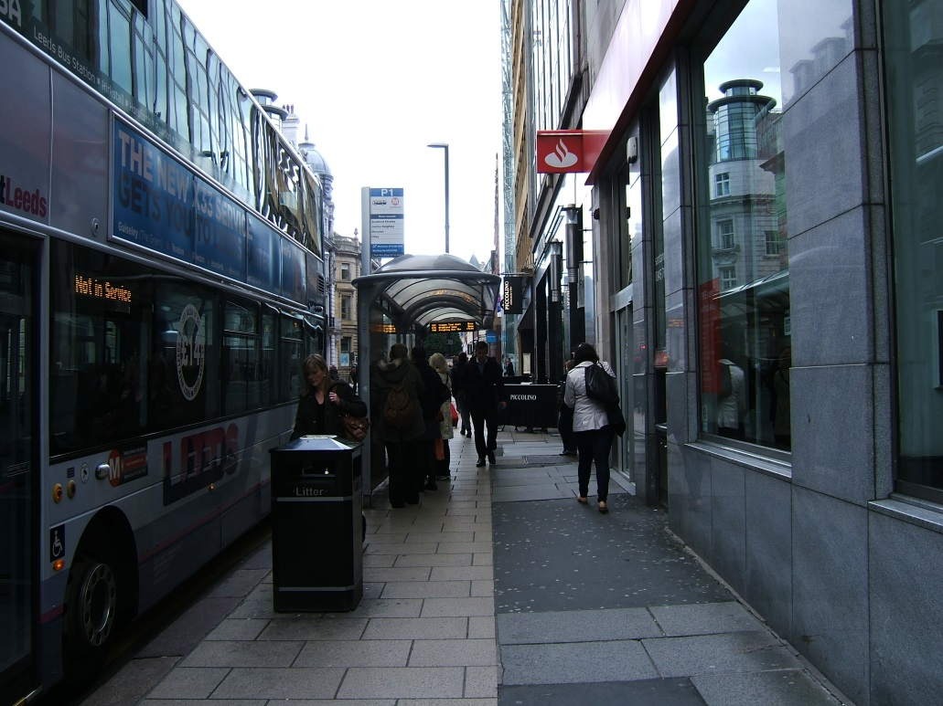
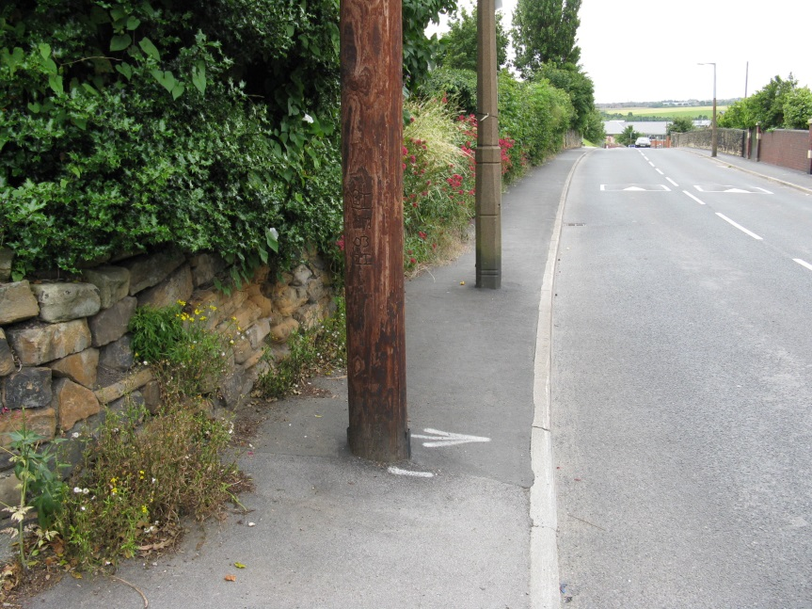
Street furniture, signs, bins, bollards, utilities boxes, lighting and other items which tend to accumulate on a footway can clutter the streetscape. Clutter is visually intrusive and has adverse implications for many disabled people.
The agencies responsible for such items and those who manage the street should consider ways of reducing their visual impact and impediment to users.
Notes:
It helps visually impaired people if, within an area, the positioning of posts etc is consistent and away from general lines of movement. Thus lamps (and signs) should be mounted on walls or buildings whenever possible; if not, then placing them at the back of the footway as near the property line as possible is acceptable. In this position the maximum distance from the property line to the outer edge of the pole should be 275mm. If they are placed on the road side of the footway, they should be at least 500mm away from the edge of the carriageway, increased to 600mm where there is severe camber or crossfall. If there is more than one pole, they should be at least 1000mm apart.

Slide 20
Towards a barrier-free environment?
https://www.google.co.uk/maps/@53.8059726,-1.5012903,17z

Slide 21
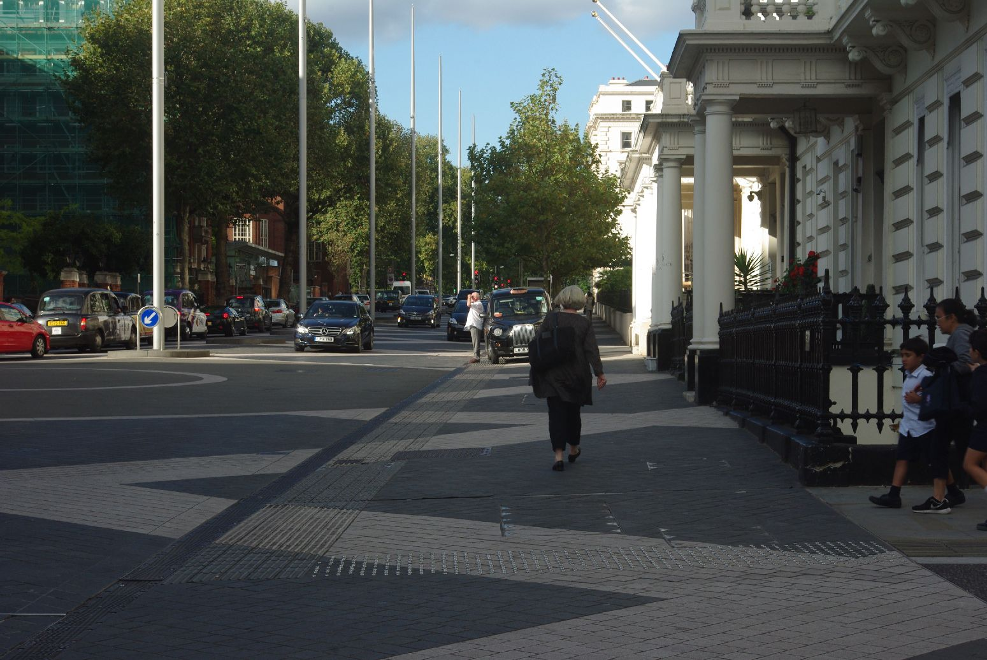

Slide 24
Conclusions
There are sufficient variations in the needs of people with disabilities, with the different needs sometimes conflicting, that Inclusive Design remains an elusive aspiration.
It is difficult to apply the current guidance to existing street layouts, and compromises have to be made in the interpretation, depending on local circumstances.
In terms of the provision of tactile paving, this may be even more difficult in non-traditional layouts, such as where a pedestrianised street meets an ‘ordinary’ street
Every element of street design could have access implications, including the elements of ‘unintentional’ design or not designed use.
Notes:
E.g. virtual shared spaces created by pavement parking, street cafes, the use of private forecourts

