Slide 1
The value, challenges and future of performance benchmarking in transport and infrastructure regulation
ITS Research Seminar
Dr Andrew Smith
Institute for Transport Studies, University of Leeds
12th March 2015

Slide 2
Outline
Principal aims of econometric analysis
Defining efficiency – why use sophisticated econometric techniques?
How can we deal with heterogeneity?
Evidence / impact: rail infrastructure efficiency in Europe (study or ORR)
Evidence / impact: study for Ofwat
Evidence / impact: vertical structure and regulation cost effects (Europe; East Asian Railways)
Conclusions / questions

Slide 3
Outline
Principal aims of econometric analysis
Defining efficiency – why use sophisticated econometric techniques?
How can we deal with heterogeneity?
Evidence / impact: rail infrastructure efficiency in Europe (study or ORR)
Evidence / impact: study for Ofwat
Evidence / impact: vertical structure and regulation cost effects (Europe; East Asian Railways)
Conclusions / questions

Slide 4
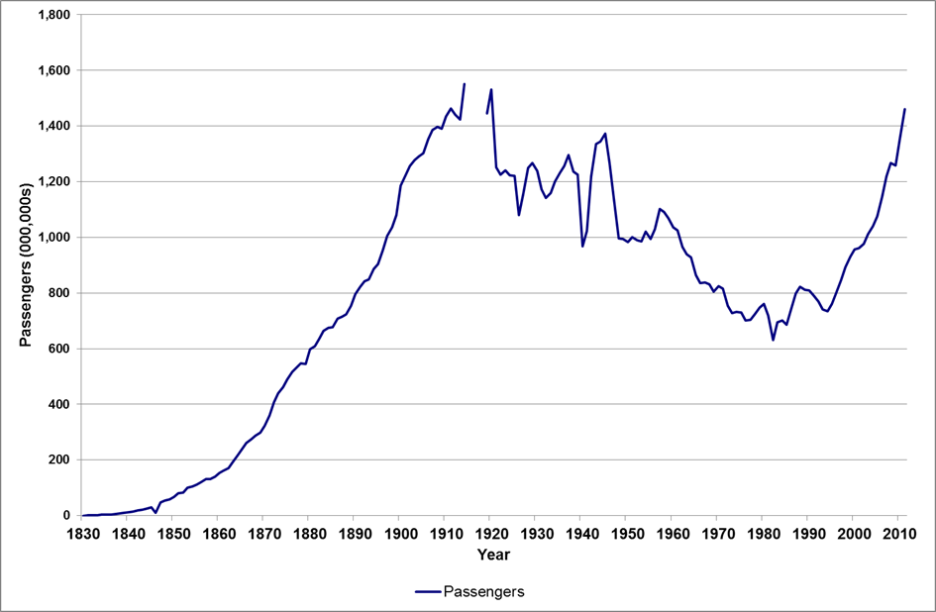
Any guesses as to what this slide is showing?

Slide 5
Passenger rail travel in Britain

Slide 6
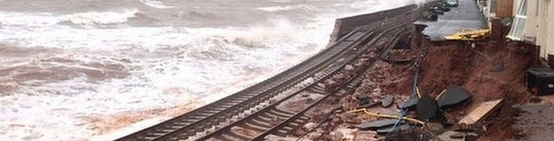
Major pressures on railways in Europe
2011 White Paper envisages:
  A 50% shift of medium distance intercity passenger and freight journeys from road to rail and waterborne transport by 2050.
In Britain: the 4Cs
  reduce costs, through improved efficiency, whilst also improving delivering better quality to customers, reducing carbon emissions, and expanding capacity
In an ever more challenging environment

Slide 7
Much has been achieved in Britain…

Slide 8
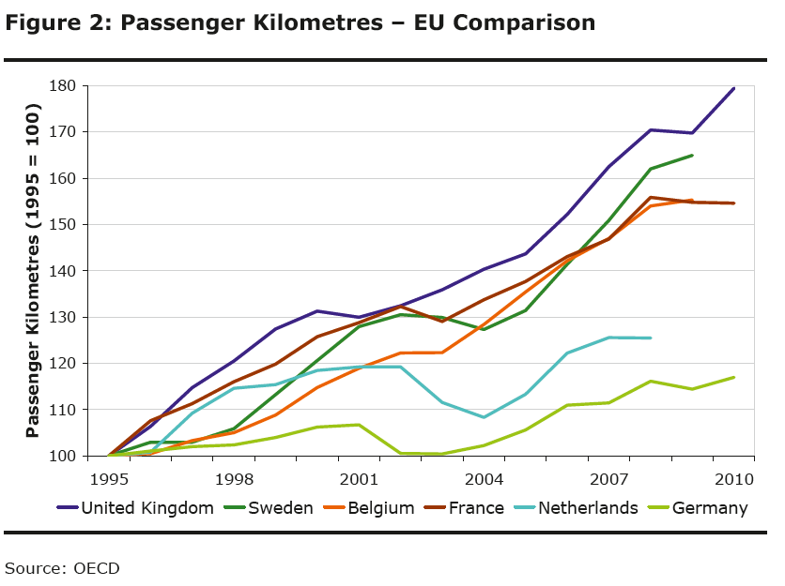
And elsewhere in Europe…

Slide 9
But…
Much to do
Step changes in performance will be needed
Implies continued and increased focus on efficiency

Slide 10


Why do econometric analysis?
Benchmarking firms against their peers - efficiency
Studying the impact of reforms (efficiency / productivity)…
Economic regulation
20-30% savings
European
rail (except
Britain…)
Vertical separation not optimal in all circumstances
45% savings
in British bus
de-regulation
Studying the cost structure of the industry
Other key sectors: energy, health, communications, postal services…
Scale / density
economies?
What is the optimal size of a rail franchise?

Slide 11
Outline
Principal aims of econometric analysis
Defining efficiency – why use sophisticated econometric techniques?
How can we deal with heterogeneity?
Evidence / impact: rail infrastructure efficiency in Europe (study or ORR)
Evidence / impact: study for Ofwat
Evidence / impact: vertical structure and regulation cost effects (Europe; East Asian Railways)
Conclusions / questions

Slide 12
A starting point for measuring efficiency – unit costs or KPIs
Unit cost measures widely used as a starting point
KPIs – Key
performance
indicators
Cost per
track km

Slide 13
A starting point for measuring efficiency – unit costs or KPIs
Unit cost measures widely used as a starting point
Problem: which denominator to use?
Econometric methods give a single measure of efficiency that simultaneously takes account of variation in train-km and track-km (and other cost drivers)
An added benefit of econometric methods: important information on scale / density economies
Cost per
track km
Cost per
train km
KPIs – Key
performance
indicators

Slide 14
Why a statistical / econometric model?
Cost
Firm A has high unit costs – is it inefficient?
Efficiency frontier
A
O
Output

Slide 15
Why a statistical / econometric model?
Cost
Efficiency frontier
A
O
Output

Slide 16
Why a statistical / econometric model?
Cost
Allow flexibility on the shape of the cost-output relationship (e.g. allow economies of scale)
Allow multiple outputs / other cost drivers (e.g. train and track-km)
Efficiency frontier
A
O
Train-km

Slide 17
Why a statistical / econometric model?
Cost
Allow flexibility on the shape of the cost-output relationship (e.g. allow economies of scale)
Allow multiple outputs / other cost drivers (e.g. train and track-km)
Efficiency frontier
A
O
Track-km

Slide 18
Why a statistical / econometric model?
Cost
Allow flexibility on the shape of the cost-output relationship (e.g. allow economies of scale)
Allow multiple outputs / other cost drivers (e.g. train and track-km)
So we can explain costs in terms of a set of explanatory factors, e.g.
  Network size; traffic density and type; other (e.g. electrification; multiple track); potentially, others…
Having accounted for these factors, and random noise, produce an overall measure of efficiency
Efficiency frontier
A
O
Output

Slide 19
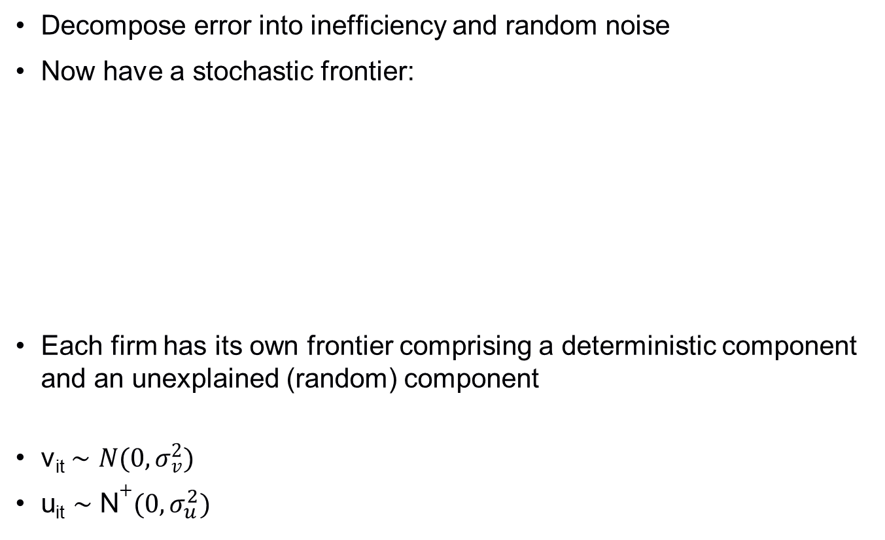
Stochastic Frontier Model
{
{
{
{
Deterministic Frontier
Noise
Inefficiency
Stochastic Frontier
Notes:
Deterministic frontier and noise equal the stochastic frontier since this is the frontier the firm actually faces (we simply account for one component using a deterministic representation and an other as noise)

Slide 20
Outline
Principal aims of econometric analysis
Defining efficiency – why use sophisticated econometric techniques?
How can we deal with heterogeneity?
Evidence / impact: rail infrastructure efficiency in Europe (study or ORR)
Evidence / impact: study for Ofwat
Evidence / impact: vertical structure and regulation cost effects (Europe; East Asian Railways)
Conclusions / questions

Slide 21
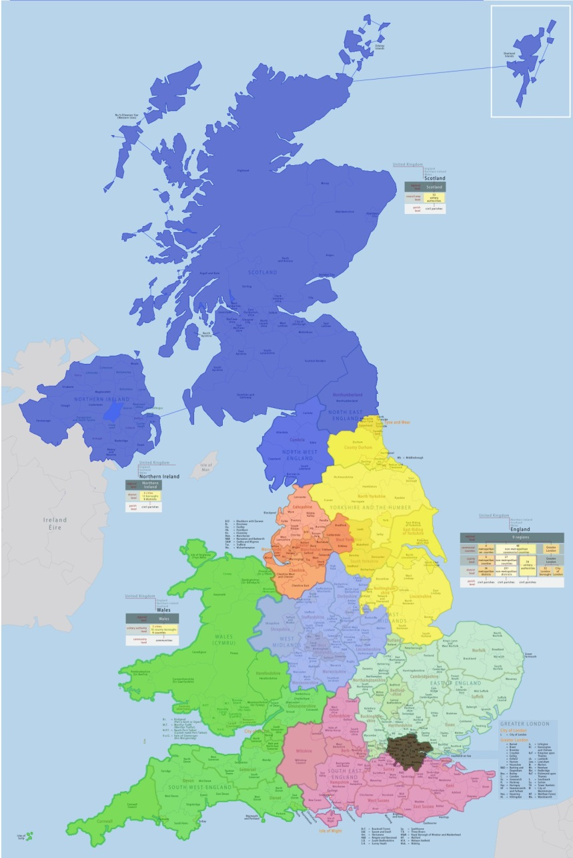
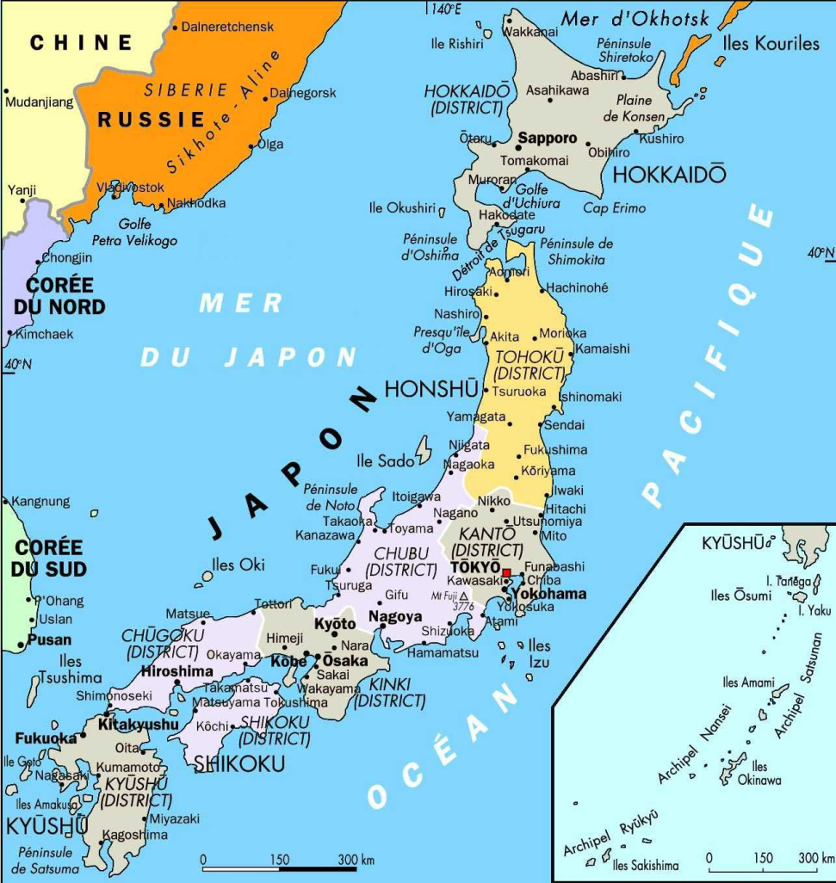
Is transport infrastructure too heterogeneous?

Slide 22
Modelling differences in characteristics and quality
Simplified representation:
C = f( W, N, Y/N, Z, Q) + error
Input prices
Network Size
Traffic
Density
e.g.
Proportion electrified
Single / multiple track
Capability (speed; axle load)
Topography
Weather…Others
e.g.
Delay minutes
Asset Failures
Track geometry
Asset age
Broken rails
……Others
OBSERVED HETEROGENEITY – MAJOR DATA CHALLENGES

Slide 23
Dealing with unobserved heterogeneity - the literature
Standard Panel: c_{i} is UOH
Schmidt and Sickles (1984): c_{i} re-interpreted (inefficiency)
The question is, how do decompose c_{i}
  Farsi et. al. (2005) – unobserved heterogeneity correlated with regressors; inefficiency is not (see also Mundlak (1978))
  Greene (2005) - unobserved heterogeneity is time invariant; inefficiency is time varying
  Kumbhakar, S. Lien, G. and Hardaker, B. (2014) – use distributional assumptions to decompose time invariant inefficiency and unobserved heterogeneity; and time varying inefficiency and random noise (four component models)
  Regulatory judgement – some kind of “ad-hoc” upper quartile adjustment
Some exciting new models here though few applications in rail yet (I’m working on that!)

Slide 24
Outline
Principal aims of econometric analysis
Defining efficiency – why use sophisticated econometric techniques?
How can we deal with heterogeneity?
Evidence / impact: rail infrastructure efficiency in Europe (study or ORR)
Evidence / impact: study for Ofwat
Evidence / impact: vertical structure and regulation cost effects (Europe; East Asian Railways)
Conclusions / questions

Slide 25
International benchmarking study
Panel data:13 European countries over 11 years
Used by International Union of Railways (UIC) in its benchmarking
Standard definitions – to an extent

Slide 26
International benchmarking study: national data – frontier parameters
Source: Smith (2012)

Slide 27
Efficiency estimates for Network Rail (PR08)
40%
gap
Implies a gap against the frontier of 40% in 2006

Slide 28
Typical UK regulatory approach
Regulators tend not to use sophisticated methods
Decomposition of noise, unobserved heterogeneity often made via regulatory judgement
Upper quartile adjustment – aim away from the frontier
Timing: ORR also allowed the company ten years to close the gap – so a 40% gap turned into 22% over 5 years (Smith et. al., 2010)
Gap confirmed by bottom-up studies

Slide 29
Outline
Principal aims of econometric analysis
Defining efficiency – why use sophisticated econometric techniques?
How can we deal with heterogeneity?
Evidence / impact: rail infrastructure efficiency in Europe (study or ORR)
Evidence / impact: study for Ofwat
Evidence / impact: vertical structure and regulation cost effects (Europe; East Asian Railways)
Conclusions / questions

Slide 30
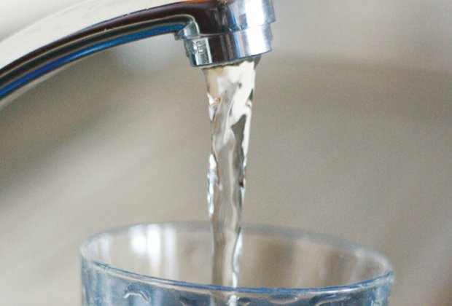
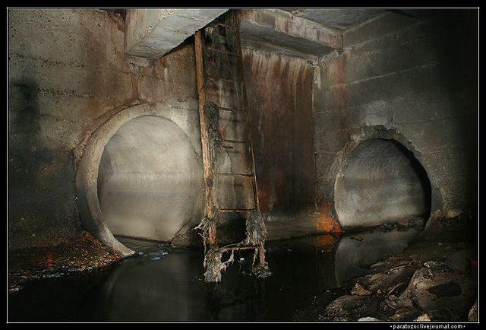
Study for Ofwat
Builds on work done in rail
Based on econometric model
Bills to fall by 5% in real terms
Tougher than what the companies wanted
Bristol water cut of 21% in real terms (now appealing)
Issue of transparency / complexity
Unobserved heterogeneity

Slide 31
Outline
Principal aims of econometric analysis
Defining efficiency – why use sophisticated econometric techniques?
How can we deal with heterogeneity?
Evidence / impact: rail infrastructure efficiency in Europe (study or ORR)
Evidence / impact: study for Ofwat
Evidence / impact: vertical structure and regulation cost effects (Europe; East Asian Railways)
Conclusions / questions

Slide 32
Research questions and contribution
In 2012 European Commission wanted to mandate full, legal separation across Europe
Research questions: does the holding company model have cost saving advantages over vertical separation and in what circumstances?

Slide 33
Reminder: Holding company model
Parent or Holding
Company
Infrastructure
Train
Operations
Fair
Access?
Regulator
Other
operators
Other
operators

Slide 34
Reminder: Rationale for holding company model
Internal separation, backed by regulation, gives fair access
Production economies of combining main train operator with infrastructure
Reduced transaction costs
Better alignment of incentives and thus co-ordination benefits

Slide 35
Measures of heterogeneity
Passenger Output; Freight output
Network size
Technology
Input prices
Load factors
Passenger revenue share
Train length
See Mizutani, F, Smith, A.S.J., Nash, C.A. and Uranishi, S (2014), Comparing the Costs of Vertical Separation, Integration, and Intermediate Organisational Structures in European and East Asian Railways,
Journal of Transport Economics and Policy (Fast Track Articles
December 2014).
Take account of economies
of scale / density before arriving at conclusions

Slide 36
Findings [1]: the answer all depends on density of usage
ΔC of vertical separation c.f. alternatives
Holding or integrated
model is desirable
Vertical separation is
desirable
Train density
Break-even point

Slide 37
Findings [2]: Commission Policy would raise costs
Notes:
Informational asymmetries:
How well informed are voters about decisions taken and their consequences?
Workers in PE suffer from an efficiency drive, but the benefits may not be ver clear to everyone else.
Why not reduce prices below marginal cost. Everyone benefits, but the implications for taxation less transparent.

Slide 38
What impact does regulation play?
Follows Mizutani, Smith, Nash and Uranishi (2014) model and earlier Mizutani and Uranishi (2013) model
Adds measure of regulation to the study
Theory: direct effect (pressure on costs of infrastructure manager); indirect effect (via enabling greater competition)
Measure of regulation extracted from IBM Rail Liberalisation Index. Covers Europe (2002-2010)

Slide 39
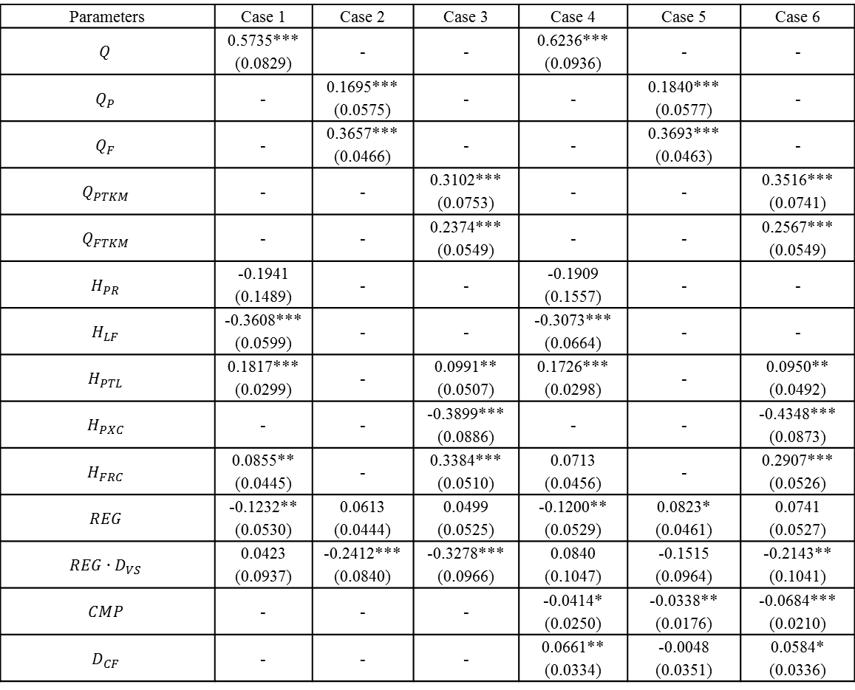
Impact of regulation results
Parameters | Case 1 | Case 2 | Case 3 | Case 4 | Case 5 | Case 6
 | 0.5735*** (0.0829) | - | - | 0.6236*** (0.0936) | - | -
 | - | 0.1695*** (0.0575) | - | - | 0.1840*** (0.0577) | -
 | - | 0.3657*** (0.0466) | - | - | 0.3693*** (0.0463) | -
 | - | - | 0.3102*** (0.0753) | - | - | 0.3516*** (0.0741)
 | - | - | 0.2374*** (0.0549) | - | - | 0.2567*** (0.0549)
 | -0.1941 (0.1489) | - | - | -0.1909 (0.1557) | - | -
 | -0.3608*** (0.0599) | - | - | -0.3073*** (0.0664) | - | -
 | 0.1817*** (0.0299) | - | 0.0991** (0.0507) | 0.1726*** (0.0298) | - | 0.0950** (0.0492)
 | - | - | -0.3899*** (0.0886) | - | - | -0.4348*** (0.0873)
 | 0.0855** (0.0445) | - | 0.3384*** (0.0510) | 0.0713 (0.0456) | - | 0.2907*** (0.0526)
 | -0.1232** (0.0530) | 0.0613 (0.0444) | 0.0499 (0.0525) | -0.1200** (0.0529) | 0.0823* (0.0461) | 0.0741 (0.0527)
 | 0.0423 (0.0937) | -0.2412*** (0.0840) | -0.3278*** (0.0966) | 0.0840 (0.1047) | -0.1515 (0.0964) | -0.2143** (0.1041)
 | - | - | - | -0.0414* (0.0250) | -0.0338** (0.0176) | -0.0684*** (0.0210)
 | - | - | - | 0.0661** (0.0334) | -0.0048 (0.0351) | 0.0584* (0.0336)
Smith, Benedetto and Nash, mimeo (2015)

Slide 40
Outline
Principal aims of econometric analysis
Defining efficiency – why use sophisticated econometric techniques?
How can we deal with heterogeneity?
Evidence / impact: rail infrastructure efficiency in Europe (study or ORR)
Evidence / impact: study for Ofwat
Evidence / impact: vertical structure and regulation cost effects (Europe; East Asian Railways)
Conclusions / questions

Slide 41
Concluding remarks [1]
Econometric modelling of costs produces key information:
  Relative efficiency of firms and impact of reforms
  Optimal cost structure of industries (scale / density)
Policy makers are using the results (e.g. economic regulators; European Commission; UK CMA)
Data is key: heterogeneity and consistency / quality of data). Collecting good quality data takes time and commitment – ideally economic regulators / Ministries need to co-ordinate
New methods to decompose unobserved heterogeneity – for application in railways – incorporate into economic regulation?

Slide 42
Concluding remarks [2]
Other wider challenges:
  Incorporating measures of quality into the analyses
  Value and cost of resilience (e.g. to climate change)

Slide 43
Questions / discussion
Thank you for your attention
Questions?
A question from me?
How far could frontier techniques be used more widely in ITS research?
Where there is something that is optimised / maximised / minimised?

Slide 44
Thank you for your attention
Andrew Smith

Slide 45
Contact details
Dr Andrew Smith
Institute for Transport Studies (ITS) and Leeds University Business School
Tel (direct): + 44 (0) 113 34 36654
Email: a.s.j.smith@its.leeds.ac.uk
Web site: www.its.leeds.ac.uk

Slide 46
References
Mizutani, F, Smith, A.S.J., Nash, C.A. and Uranishi, S (2014), Comparing the Costs of Vertical Separation, Integration, and Intermediate Organisational Structures in European and East Asian Railways, Journal of Transport Economics and Policy (Fast Track Articles December 2014).
Smith, A.S.J (2012), ‘The application of stochastic frontier panel models in economic regulation: Experience from the European rail sector’, Transportation Research Part E, 48, pp. 503–515.
Smith, A.S.J., Wheat, P.E. and Smith, G. (2010), ‘The role of international benchmarking in developing rail infrastructure efficiency estimates’, Utilities Policy, vol. 18, 86-93.

Slide 47
References
Kumbhakar, S.C., Lien, G. and Hardaker, J.B. (2014), ‘Technical efficiency in competing panel data models: a study of Norwegian grain farming’, Journal of Productivity Analysis, 41, 321-37.
Farsi, M., Filippini, M. and Kuenzle, M. 2005. Unobserved heterogeneity in stochastic cost frontier models: an application to Swiss nursing homes. Applied Economics, 37(18): 2127-2141.
Greene, W. (2005), ‘Reconsidering heterogeneity in panel data estimators of the stochastic frontier model’, Journal of Econometrics, vol. 126, pp. 269-303.

