Slide 1
Peter Stoner
1983 BA Town & Country Planning
1985 MA Transport Economics
Tyne & Wear PTE, Cumbria CC, Northumberland CC
2005 Traveline UK
2013 Ito World Ltd

Slide 2
How to maintain Public transport Information for Google Maps that is
Comprehensive
Integrated
Up to date
Accurate

Slide 3
How to maintain Public transport Information for Google Maps that is
Comprehensive
Integrated
Up to date
Accurate
Static schedules
Real Time
Infrastructure

Slide 4
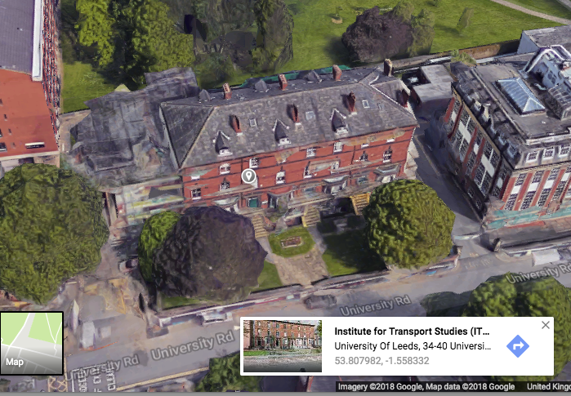

Slide 5
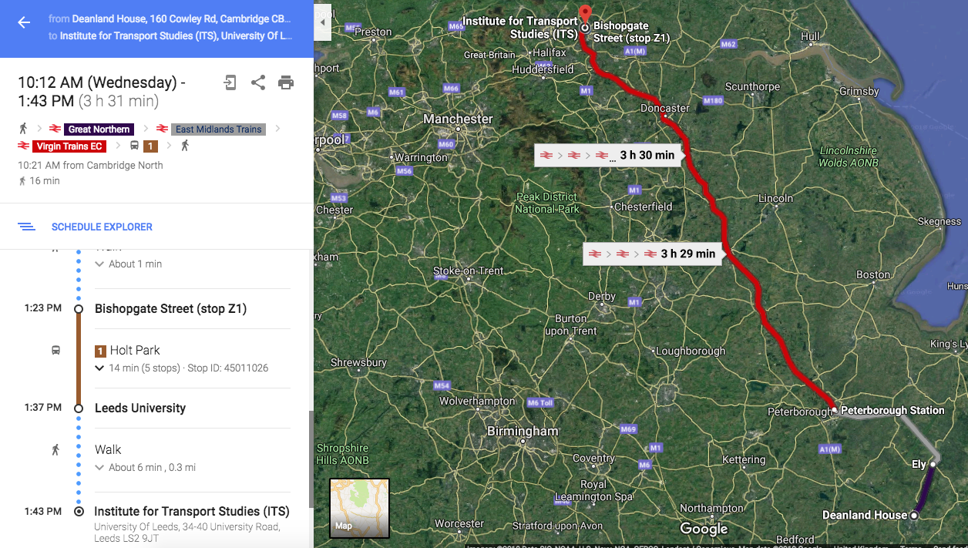

Slide 6
Brief history
1980s | Deregulation | Transport Act 1985
1990s | Information Standards | NaPTAN , ATCO CIF, TransXchange (GTFS later)
2000s | National Information services | Traveline, Transport Direct, Google Transit started
2010s | Open Data | Used by Google Maps

Slide 7
People
Nick Knowles
Helen Roach
Nick Illsley
Roger Slevin
Chris Gibbard
John Elliot
Tony Ferguson

Slide 8
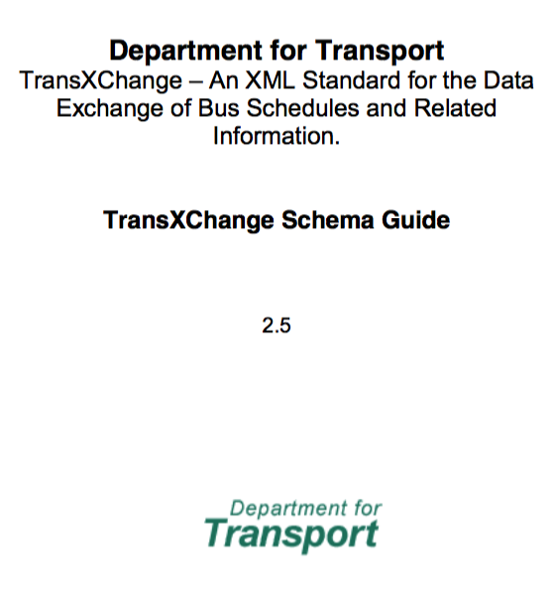
Transmodel
Real time feeds (ST, ET)
Disruption (Siri SX)
Journeys (TransXchange)
Patterns (TransXchange)
Links (TransXchange)
Stops (NaPTAN)

Slide 9
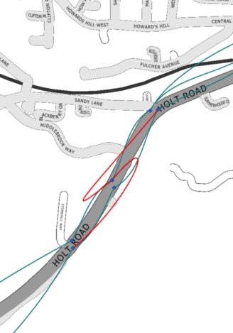
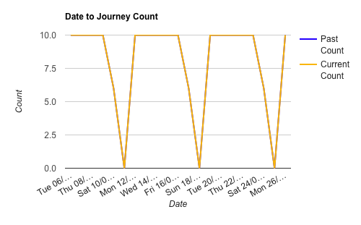
Tools
Tests and Warnings
Bezier curves
Interventions / overrides
Fingerprints

Slide 10
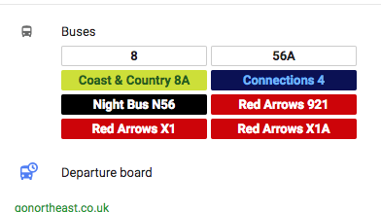
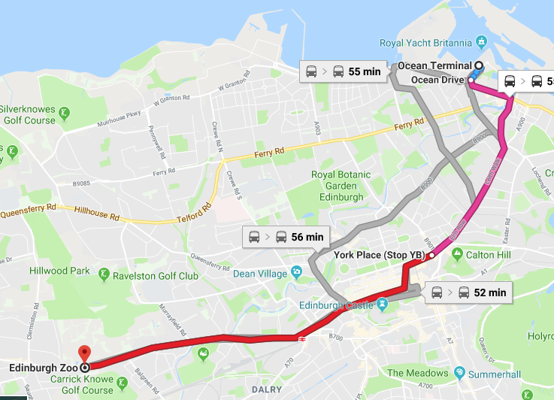
Enhancements
Line colours and branding
Operator names
Planned Disruption

Slide 11
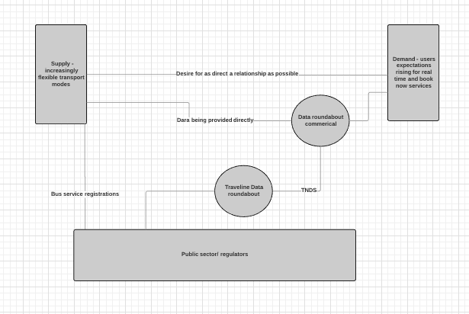
Data Chain

Slide 12
Comprehensive
Public Transport Modes
Walking, Cycling, Taxis, Demand Responsive
Operators
City, Region, National, International
Fares
Real time coverage

Slide 13
Integrated
Stops
Interchanges
Fares
Real time journey planning
Walking, cycling

Slide 14
Up to Date
Timeliness of processing
Planned Disruptions
Real time
Look ahead horizon

Slide 15
Accurate
“Ground truth”
Place Names, Destinations/Headsigns
Locations, Stop order,
Predictions, real time testing

Slide 16
Peter Stoner
14 February 2018
Any questions
Thank you for your interest

